Slide 1

Stephen Thorn
13th June 2023

Slide 3
Welcome: Introduction
Welcome to today’s session

Slide 4
Welcome: Agenda
How to produce a Marketing and Communications plan which supports fundraising activity
  Welcome & Introduction – Jayne Thomas, Network Manager.
  We will be recording today’s session.

Slide 5
Welcome: Agenda
How to produce a Marketing and Communications plan which supports fundraising activity :
  Firstly, we’ll look at your advanced feedback on the subject.
  Then we’ll learn what constitutes a marketing and communications plan.
  It will demonstrate how good marketing and communication practice is the basis for all sustainable income generation – and so much else besides.
  This webinar will include ‘quick win’ ideas for creating marketing and communication initiatives that could drive immediate income opportunities.
  1.15pm finish with another 15 minutes for those that have time for Q&A on any specific issues

Slide 6
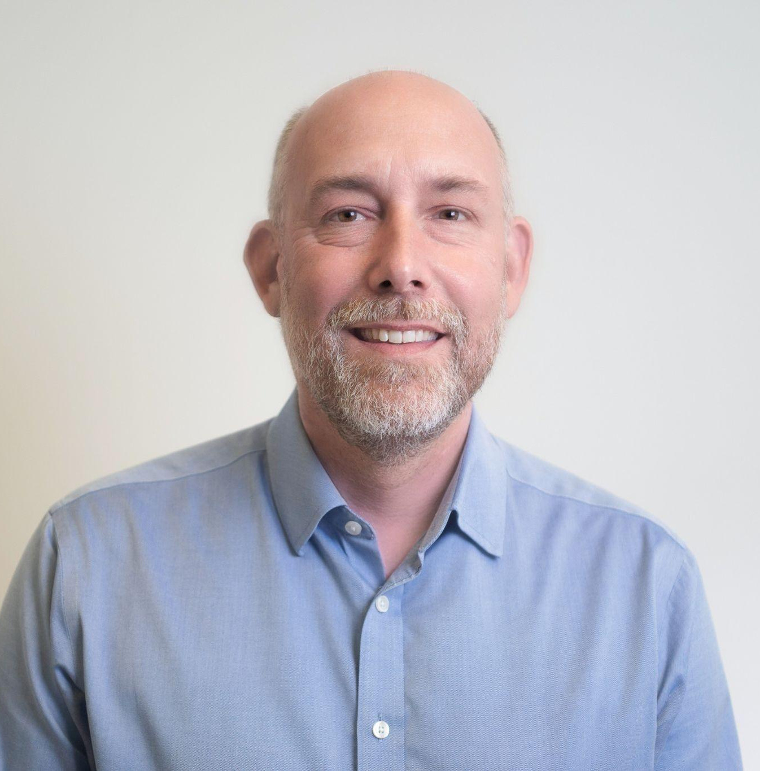
Welcome: Introduction
Stephen Thorn has worked as a Senior Executive, Director and Board Member of commercial and nonprofit organisations where he has been responsible for marketing, fundraising, and business development functions. Over the last ten years he has developed a specialist focus on not-for-profit and charity sector strategic business planning, organisational design, and sustainable impact solutions.
He has served as the Sales & Marketing Director of Woodmansterne Publications, Fundraising Director and Interim CEO for international street children’s charity Toybox and is a Preferred Supplier to the City Bridge Trust. He was a consultant and then founding executive of the EY (previously Ernst & Young) Foundation which supports disadvantaged young people into the workplace, where as Head of Business Development, Communications and External Relations he established a £multi-million fundraising operation from scratch.
A Postgraduate (DipM) and Member of the Chartered Institute of Marketing (MCIM), Stephen also has an MSc in NGO Management and is an alumnus of the INSEAD Social Enterprise Programme (ISEP). He was previously the Chair of Trustees of Big Picture Learning UK. Recent clients have included business development strategy for international humanitarian initiative Response Innovation Lab, marketing and fundraising strategy and planning for the Cranfield Trust, performance management consultancy for Children and Families Across Borders and organisational development benchmarking and strategic recommendations for Versus Arthritis, NHS, Caritas, and the Samaritans.

Slide 7
How to produce a Marketing and Communications plan which supports fundraising activity
Bayes Business School (formerly Cass)

Slide 8
Your feedback in advance
Bayes Business School (formerly Cass)

Slide 9
Questions ahead of todays session:
Three quarters of you have either no or not updated marketing and communications plan

Slide 10
Questions ahead of todays session:
NOT NEEDED
Over half of you have no dedicated support or not enough support
NO
YES, BUT NOT ENOUGH (TIME)

Slide 11
Questions ahead of todays session:
STRONG
MIXED
80% of you could have a stronger profile in the local community
HISTORIC
ACCEPTABLE
LOW

Slide 12
Questions ahead of todays session:
If there was one solution you were hoping to find from this workshop, what would that be?
New ideas to raise brand awareness in the local community.
Guidance and tips on developing our marketing and comms strategy and producing a plan.
Marketing to commissioners.
To implement the plan successfully with limited staff and financial resources.
What are the differences when planning for a charity.
How to collate data across teams and use it effectively to talk to our audience. Identify our audience better.
Getting the messaging right.
To better understand the process of developing a marketing plan.
Effective tools for keeping on top of updating our communications - especially online.
How to market more effectively with the limited resources we have.

Slide 13
Recap of June 2022’s webinar - Using data, information and knowledge for growth and impact
Six themes, each with a homework:
Conduct a data mapping exercise
Get a small group together (it might be just two of you; one of them might be your aunt) to discuss data and information for income generation
Write a Case for Support
Track a supporter journey. Build on that over time.
Create a couple of new stories and case studies.
Write a simple fundraising, marketing and communications plan.
Do request the slide deck if you would find that useful.

Slide 14
Recap of January 2023’s webinar - A new year, a new challenge - how to plan to thrive in tough times
Six themes:
Minimise opportunities.
Minimise threats.
Refresh your planning.
Quick wins for fundraising.

Slide 15
Marketing
Bayes Business School (formerly Cass)

Slide 16
What is marketing
Marketing is the theory and practice of identifying, anticipating and meeting your stakeholders needs.
Marketing is essential for nonprofits because to elicit support in the form of donations, volunteers and other resources we need to have a process and a bunch of tools that we can use to build trusted relationships.
Marketing practice can include mapping supporter journeys, collecting and analysing supporter feedback, segmenting stakeholders into groups, creating ‘personas’ that represent these groups.
Marketing tools can include CRM systems, digital marketing apps and platforms
Strategic marketing is the deployment of activity based on high-level analysis and planning based on stakeholder’s needs and expectations.
Strategic marketing tools include planning tools like the BCG matrix and positioning and portfolio analysis

Slide 17
Communications
Bayes Business School (formerly Cass)

Slide 18
What is communications
Communications is getting a message out to an audience. Ideally it’s a two-way dialogue.
Communications is essential for nonprofits because it bridges the gap between the supporters and service users. In a commercial organisations there is direct contact between the goods or services sold and the customer. In nonprofits the supporter and service user may never meet.
Communications practice includes creating a Case for Support to understand what inspires and motivates stakeholders and how the charity should respond to those motivations. Based on this, communications plans the right messaging and content (which can be classed as Tier 1 and Tier 2) to go out via the right channels (online and offline) at the right time with the intention to reach the right audience, creating the right effect.
Communications tools can include social media platform platforms such as Hootsuite and Social Bee, visual and branding tools such as Photoshop and Canva, SEO tools like Google Analytics, and applications such as Twitter, Instagram and Facebook.
Strategic communications involves high-level analysis and planning to influence behaviours and responses, typically for a campaign or outreach project.

Slide 19
What constitutes a marketing and communications plan
Bayes Business School (formerly Cass)

Slide 20
Marketing and Communications (and fundraising too)
There is a healthy crossover between the theory and practice of marketing and the theory and practice of communications.
For example, it may be regarded as a marketing activity to segment supporters according to the geodemographic themes, then a joint marketing/communications activity to develop personas that represent those groups, and then communications creates messaging and content to create a response from those groups.
Fundraising comes directly into the picture because the response planned may be the motivation to provide a donation. Without marketing and communications, the fundraising function may never have understood the right thing to say to the right people at the right time using the right channels. It may never have known that that the particular group existed and how to reach them.
Fundraising is supported in an indirect way because marketing and communications helps to build trusted, long-term relationships between supporters and your cause, and even looks to find new audiences that will become supporters and donors in the future.
Sometime strategic fundraising is the bit of fundraising that seeks to bind in aspects of marketing and communications in the absence of those functions being available.

Slide 21
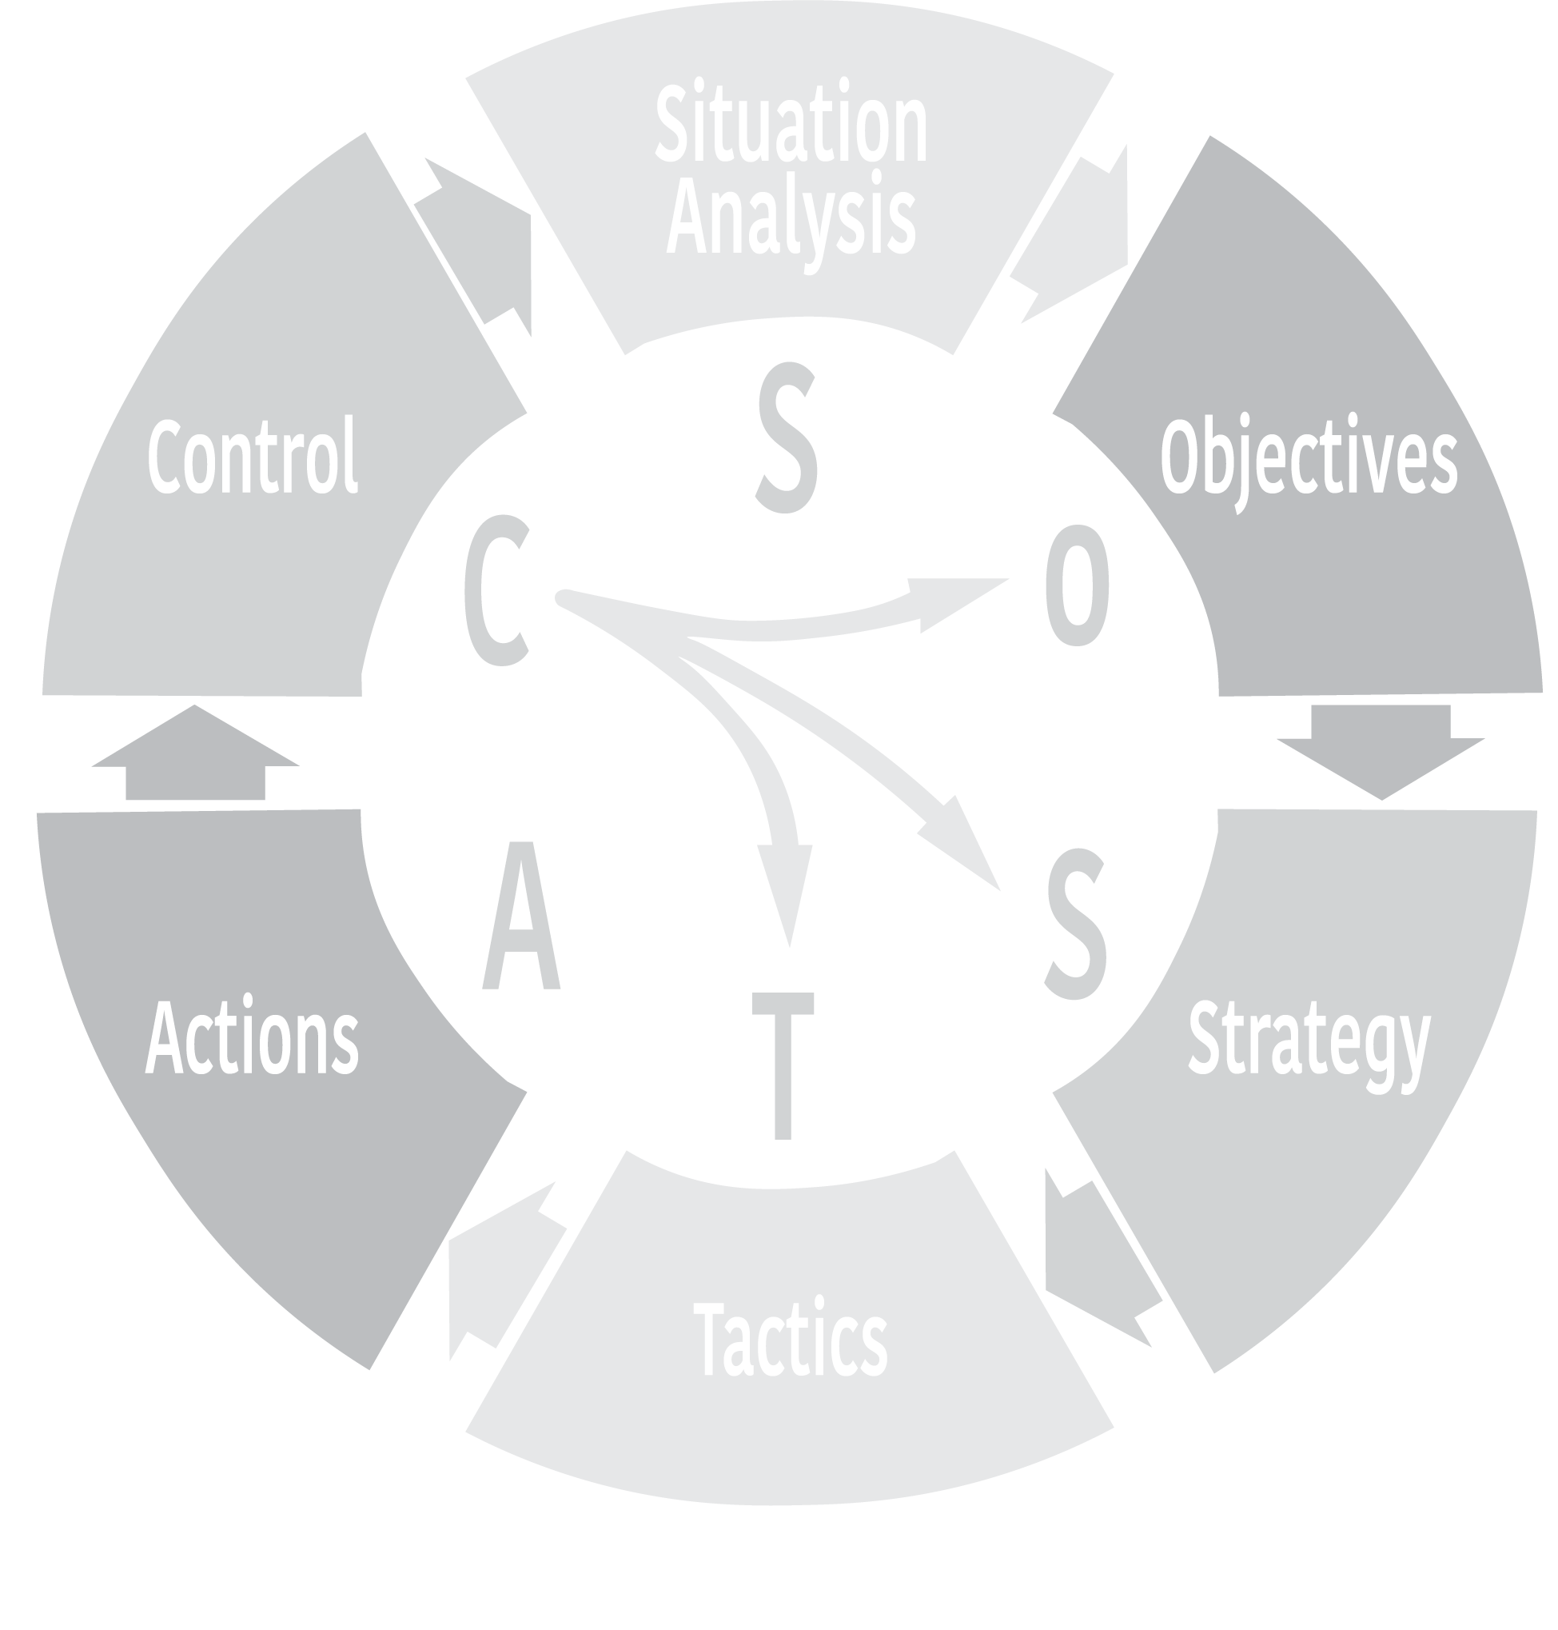
Here’s a planning framework that works for the whole business plan and/or the marketing and communications plan and/or the fundraising plan.
Where are we now?
Where do we want to be?
How do we monitor performance?
How do we get there?
The details of the tactics
How exactly do we get there?

Slide 22
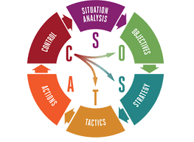
SOSTAC Planning Framework
Executive Summary
Vision, Mission, Values
Situation – SWOT, PESTLE, Peers & Partners,
Stakeholder Mapping, Audience Typology
Objectives – SMART
Strategy – Theory of Change, Porter’s Generic Strategy,
Tactics – Communication Content (Case for Support), Channels, Engagement, Income Streams
Actions – what, how, when, who, what cost? (Gantt, Asana, MS Planner, Monday.com)
Control – Checking up on objectives. Monitoring & Evaluation. Case Studies. Impact reports.

Slide 23

Integration with fundraising
Remember that your fundraising team or other areas of the organisation may already have done some thinking that would be useful as a basis for the marketing and communications plan.
This could include useful work around mission, vision, and values.
They may even have carried out a SWOT, a PESTLE, and perhaps researched peers & partners,
If the fundraising team have been strategic, then they may have done some stakeholder mapping, audience segmentation or even created some personas. They may be running the CRM system?
And some of your work to develop a marketing and communications plan may overlap and should align with their work. What do they need from you to support their fundraising efforts? And are there activities such as community events that work for all departments – raising brand awareness, building strong relationships and with an opportunity to do some fundraising too?

Slide 24
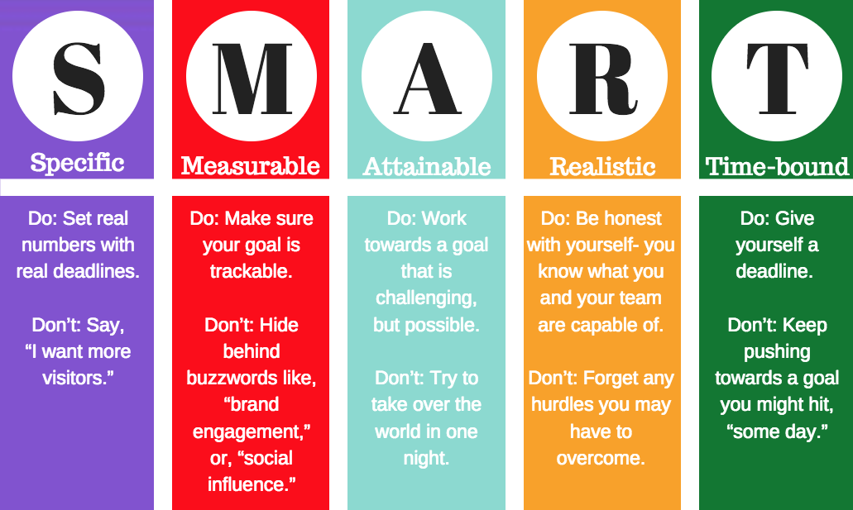
SMART Objectives

Slide 25
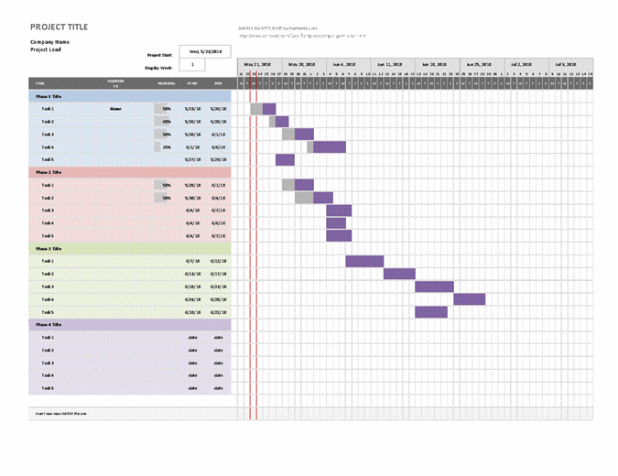
Gantt Chart

Slide 26
Marketing and communications plan – the OKR Dashboard
Bayes Business School (formerly Cass)

Slide 27
OKRs (Objectives, Key Results)
A key read is ‘Measure what Matters’ by John Doerr
https://www.amazon.co.uk/Measure-What-Matters-Simple-Drives/dp/024134848X
The OKRs system is built on four key themes:
The first is focusing on the handful of initiatives that can make a real difference and deferring the less important ones; this allows leaders to commit to those choices and makes for a successful organisation.
The second is the ability to align and connect. OKR transparency means that not only are everyone's goals openly shared, but individuals also link their objectives to the company's overall game plan, and coordinate with other teams.
The third OKR theme is that they can be tracked; they are driven by data, with periodic check-ins, objective grading, and continuous reassessment.
The final OKR theme is the system's ability to motivate people to excel by doing more than they had thought possible. Setting conservative goals stymies innovation; setting ambitious 'stretch' goals encourages people to go outside their comfort zones.

Slide 28
OKRs Dashboard
You can build an OKR Dashboard in Excel to start with.
The headers can be anything you choose, but the Objective (SMART) has to be present (what are you trying to do, by when) as does the Action (what will you do, specifically) following by the Key Result (the Indicator that allows you to assess if the Action achieve the mission).
Key Theme | Why important | Objective | Key Result Output | Key Result Indicator(s) | Timeline | Owner / Lead | Assist(s) | When Board to check progress

Slide 29
OKR Dashboard
Understand and increase existing supporter engagement (marketing) | Planning supporter engagement activity is crucial in building trusted, lasting relationship that support fundraising, volunteering and other resource acquisition. |  | Assess the current CRM system against a list of required functionality (current and future) | Make a decision as to whether XXX will stand the test of time. If not, then set a date at which the system will be upgraded and develop a plan to deliver. | Q1 2024 | XXX | Support from XXX
 |  |  | Run new reports that analyse aspects of stakeholder management such as acquisition and retention, LTV and supporter journeys. | Test and run at least 3 new reports this year | Nov | XXX | Support from XXX
 |  |  | Begin to segment the database based on the four types of segmentation outlined in this report | Test and run at least 1 new basic segmentation report and draw at least 3 new insights | Nov | XXX | Support from XXX
 |  |  | Think about the stakeholder base and develop some personas to inform marketing and communication activity. | Develop at least 3 personas that represent sections of the supporter base | Q1 2024 | XXX | Support from XXX

Slide 30
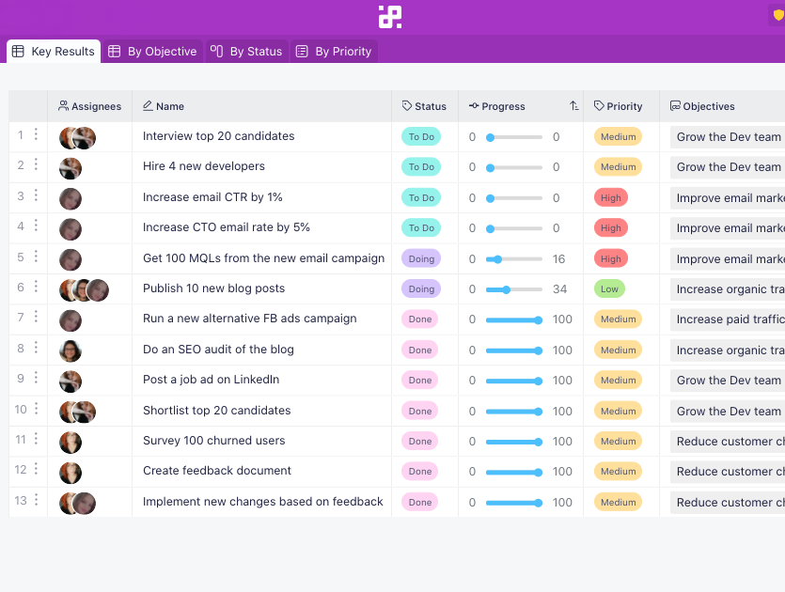
OKRs Dashboard
You can transfer OKR Dashboard into a project/task management platform like Asana – for free.
Not only does this give you a secure, robust platform for your information but it allows a team (staff/volunteers) to share objectives and actions and record progress wherever they are. (No more version control on Word or Excel documents which are pinged around by email).

Slide 31
Provide a framework for fundraising, marketing and comms plans
Key headers for a great marketing, fundraising and comms plan, ideally set over three years:
Goals (marketing goals, fundraising goals, communications goals)
Messaging (Key Messaging, Case for Support)
Audiences (segmenting the charity’s stakeholders - personas)
Channels (Existing, New, include Digital (social media & website)
Resources (Timing, People, Budget)
Actions (prioritise, set critical paths, use Excel, Gantt, MS Project, Monday.com or Asana planning tools)
Control (measuring achievement against Goals)

Slide 32
Getting the messaging right: the Case for Support
Bayes Business School (formerly Cass)

Slide 33
Case for Support
The Case for Support is an internal document that provides the platform for messaging and communication to stakeholders based on an attempt to understand what motivates supporters and how the charity can encourage greater engagement. The Case for Support can be used for framing all forms of communication including: Press release, Website copy, Social media content, Fundraising asks.
Who are we?
XXX is a non-profit organisation that provides vital support to unpaid carers in the Harrow community.
Our goal is to ‘to improve the wellbeing and resilience of carers of all ages and backgrounds so that they can continue to provide support for the people they care for without compromising their own health, social networks and ability to contribute to society.’ XXX provides a range of services that are designed to meet the diverse needs of carers in our community. We offer information and advice, counselling services, activity programmes, employment support, practical help, training, and social activities that help carers to maintain their own well-being and build resilience. We are uniquely positioned to offer specialist advice and signpost both carers and the people they care for on to relevant specialised sources of support in Harrow.’
Work with us
Working together we can realise the vision of a friendly, supportive and positive community Harrow where unpaid carers are recognised, supported and cared for in turn. Together we have the power to make a significant impact on the lives of unpaid carers in our community. With your support, we can provide vital services that enable carers to continue caring with confidence and dignity. In partnership we can support over 5000 carers and their families every year.
Join our family of supporters
Our supporters love XXX because they know that we provide essential support to carers in our community, helping them to maintain their own well-being while providing care to others. People from across Harrow and beyond join us because they want to see our community thrive and for no one to go unnoticed and unsupported. We are already accomplishing so much, and with your support we can make even more progress, encouraging those working as carers know that there is a broader community family supporting them.

Slide 34
Case for Support
We’ll work for you too
Our small, efficient team will keep you informed and up-to-speed with everything that is happening in the charity. You’ll regularly receive updates of the activity that we’re doing directly and through our amazing support workers. We’ll inform you of the latest developments and exciting progress that is being made every day, and how our people are making a difference through your support. They’ll be a chance to meet the team every year in-person or virtually when we publish our Impact Report. And we’ll never forget to thank you for your time and financial support, and recognise your commitment to our work together.
How can you support us?
Sign up to our newsletter and follow us on Facebook, Twitter or Instagram to keep up to date with our work and discover more offers of how to get involved including volunteering opportunities. Spread the word through liking and sharing our social media content, introduce your friends and network to our work, and let us know what more we can do to inform and inspire you. We would love for you to donate to our work and it is easy to give a one-off donation or simply sign up for a regular monthly donation of whatever amount is best for you. Or perhaps make a larger donation directly towards our community work or annual grant giving round? For the long-term sustainability of our mission, would you consider leaving a gift in your will? Consider recommending us to your workplace for them to hear more about our Corporate Partner opportunities.
What do you get in return from us?
You will become a part of our vibrant, growing, XXX community, giving you the assurance and peace of mind that your contribution is making a positive difference to the people of Harrow. So much good is already happening to turn the tide towards Harrow becoming a place where hardworking carers are loved and supported. Join us, and together as a community, we can make change happen - your local carers need you!

Slide 35
Audiences
Bayes Business School (formerly Cass)

Slide 36
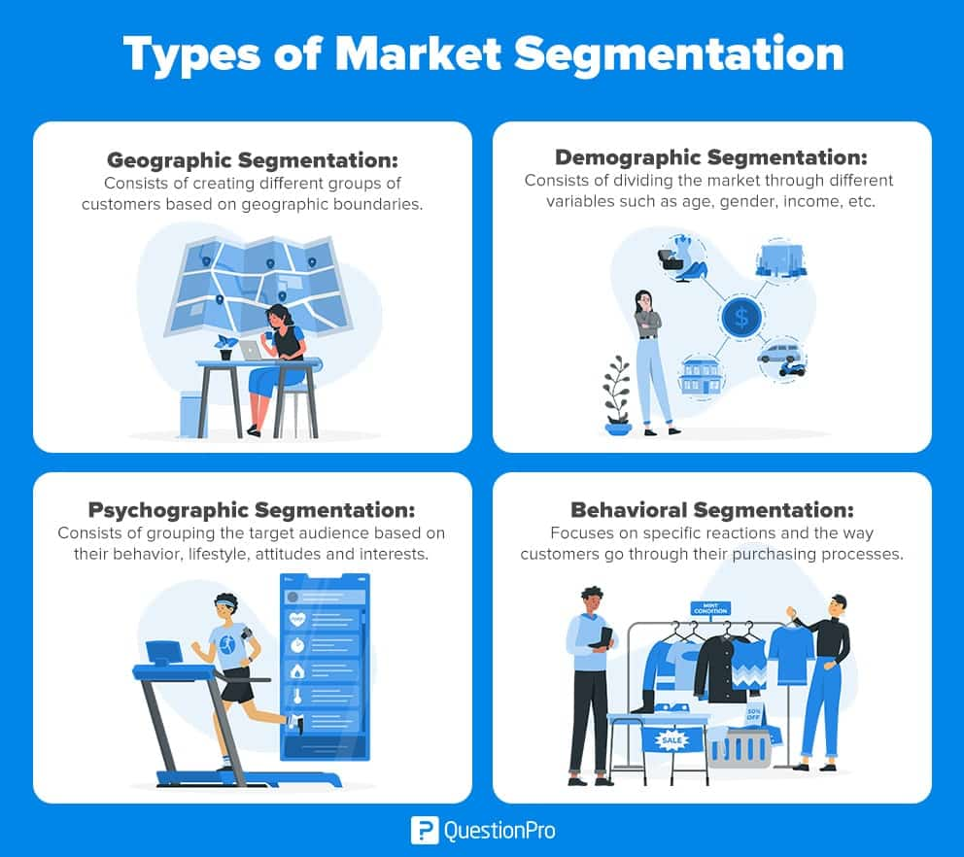
Segmentation
Consider the types of supporter and stakeholder you need to target for each part of the mission of the charity. Segment those groups by:
Demographics
Psychographics
Behavioural characteristics
Geography

Slide 37
Personas
Bayes Business School (formerly Cass)

Slide 38
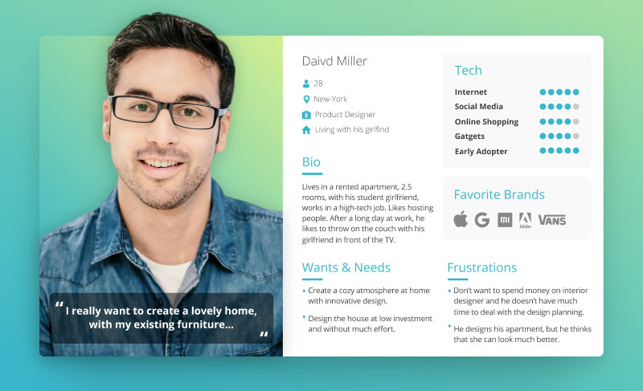
Segmentation
Consider creating characters who broadly represent the different segments of your audience. You can consider:
Name
Age
Location
Job
Family lifecycle
Short biography
Wants and Needs
Tech Level
Favourite brands
Frustrations
This will help you choose the messaging, channels and timing for your communication to the group that they represent that will stand the best chance of a positive response.

Slide 39
Digital marketing
Bayes Business School (formerly Cass)

Slide 40
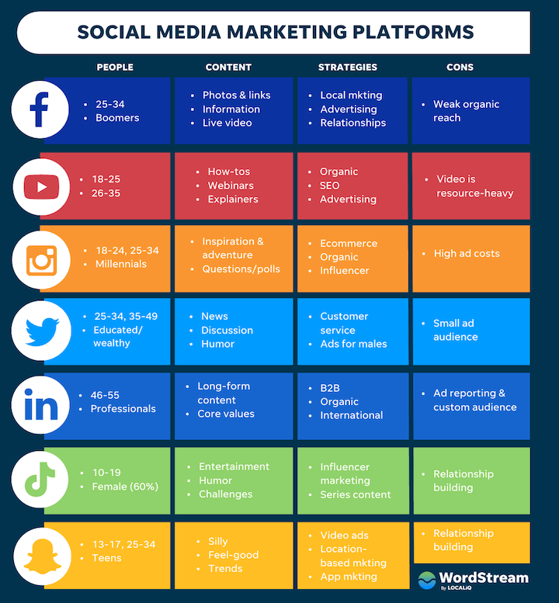
Digital marketing
Leverage digital platforms to amplify your organisation's message. Develop a comprehensive digital marketing strategy that includes search engine optimisation (SEO), search engine marketing (SEM), social media marketing, email marketing, and influencer partnerships. Consider the digital channel(s) carefully to match your messaging.

Slide 41
Specific support for fundraising activity
Bayes Business School (formerly Cass)

Slide 42
Providing marketing and communication support for event fundraising
Supporting Sponsored Event fundraising
To encourage individual giving based on a sponsored event, like a fun run, and to save the charity team time then a simple sponsorship pack can be created and posted on the website detailing the steps that a supporter can take to organise their own personal fundraising campaign and give the proceeds to the charity. (https://www.cancerresearchuk.org/get-involved/do-your-own-fundraising/get-fundraising-pack)

Slide 43
Providing marketing and communication support for corporate fundraising
Supporting corporate fundraising
The four steps to corporate fundraising are research, content, ask, build/ maintain relationships.
Step 1: Research
Google (organisations with connections to the local area or supported group).
Local network of existing contacts (Trustees and ex-Trustees’ networks)
Local Media and Social Media shout-outs.
Step 2: Content
It is suggested that the charity create a short ‘deck’ (this usually consists of 7 – 10 PowerPoint slides with graphics) based on a Case for Support with a very specific Ask.
Step 3: Ask
The Ask should be specific, but it can be for more than one element. For example, this could be financial support and/or resources (including people through secondments, use of workspace etc) and/or other support such as ‘Charity of the Year’ or introducing the charity to its network, or supporting with social media building etc.
Step 4: Build / Maintain relationships Once corporate support has been secured it will be important to keep in contact with the key contact at the business and report on progress and activity, and to explore ideas for new ways of working together for mutual benefit.

Slide 44
Providing marketing and communication support for legacy fundraising
Research and Development
Develop a clear long-term legacy vision (in the form of a tailored Case for Support).
Develop funding statements for use everywhere and by everyone in key messages statements on the website and in service communications (such as email, see Channels, below).
Consider offering peripheral offerings such around In Memoriam. Research services such as MuchLoved) and advice around adding simple Codicils to supporter’s existing wills.
Offer a Will writing service (such as Kwil) or access to a professional adviser.
Create legacy messaging for different channels
A Legacy leaflet
Home page of your website
A ‘P.S.’ in all donations thank you letters
As an email signature
At all events
Posters (large print) at the Celebration event
Face to face with clients
Incorporated into any videos

Slide 45
Did we cover all the issues and questions?
Covered in the previous sections
Guidance and tips on developing our marketing and comms strategy and producing a plan.
To better understand the process of developing a marketing plan.
Getting the messaging right.
How to collate data across teams and use it effectively to talk to our audience. Identify our audience better
Cover in this next section
What are the differences when planning for a charity?
How to market to commissioners.
New ideas to raise brand awareness in the local community.
To implement the plan successfully with limited staff and financial resources.
How to market more effectively with the limited resources we have.
Effective tools for keeping on top of updating our communications - especially online

Slide 46
Did we cover all the issues and questions?

Slide 47
What are the differences when planning for charity?
Bayes Business School (formerly Cass)

Slide 48
Marketing and Communications – differences in charity practice
CONS
Budget constraints.
Staff constraints.
The supporter-beneficiary paradox.
Complex rewarding and recognition.
The complexity of the stakeholder ecosystem.
Cutting through the ‘noise’.
Evidencing impact.
PROS
Discounted, subsidised and free resources.
Volunteers and Trustees.
Passionate teams.
Pro bono support.
Inspirational cause.
Authenticity.
Case studies and testimonials.

Slide 49
How to market to commissioners?
Bayes Business School (formerly Cass)

Slide 50
How do we market ourselves to commissioners? 10 Actions.
Clearly define your mission and goals: Clearly articulate your charity's mission, vision, and objectives. Explain how your organisation addresses the needs of people with learning disabilities in your particular geographic area and how your work aligns with the priorities of commissioners.
Showcase your expertise and experience: Highlight the knowledge, skills, and experience of your staff, volunteers, and trustees. Emphasize any specialized training, certifications, or qualifications that demonstrate your credibility and ability to provide high-quality services.
Provide evidence of impact: Compile data and success stories that demonstrate the positive outcomes your charity has achieved. Show how your programs and services have improved the lives of individuals with learning disabilities and their families. Use testimonials, case studies, and statistics to provide a compelling narrative of the difference you make.
Collaborate with partners: Highlight any partnerships you have formed with local authorities, health services, educational institutions, or other relevant organizations. Demonstrating strong collaborations enhances your credibility and shows your commitment to working in partnership with commissioners.
Tailor your approach: Research the specific priorities and objectives of the commissioners you are targeting. Understand their funding criteria and how your charity aligns with their goals. Customize your marketing materials and communications to address their specific needs and interests.

Slide 51
How do we market ourselves to commissioners? 10 Actions.
Develop a comprehensive marketing plan: Create a strategic marketing plan that includes a mix of online and offline Objectives with Key Result Actions and Indicators. Utilise your website, social media channels, and email marketing to raise awareness and showcase your work. Develop compelling content, such as blog posts, videos, and infographics, to engage commissioners and demonstrate your expertise. Transfer the plan into Asana (or other online project management system).
Network and attend relevant events: Participate in conferences, seminars, and networking events where you can connect with commissioners. Engage in conversations, share your knowledge, and build relationships. Attend meetings of local government bodies and committees to gain visibility and influence.
Engage with commissioners directly: Request meetings with commissioners to discuss your charity's work, impact, and future plans. Prepare a concise and compelling pitch that highlights the benefits of partnering with your organization. Be prepared to answer questions and provide additional information as needed.
Develop partnerships with other organisations: Consider collaborating with other charities or service providers to offer joint programs or initiatives. Partnering with reputable organizations can strengthen your credibility and expand your reach.
Keep up with legislative and policy changes: Stay informed about any changes in legislation or policy related to learning disabilities or the charity sector. Adapt your marketing messages and strategies accordingly to align with current priorities and requirements..

Slide 52
How do we market ourselves to commissioners? 10 Actions.
MARKETING | Marketing our organisation is a crucial activity to ensure that their recognition of our credibility and unique ability to deliver successful new programmes. | Successful increase in commissioned activity | Ensure our mission and goals and sufficiently well developed and communicated to attract the commissioner’s attention | Benchmark our mission and goals against other charities that have been successful in eliciting commissions. Refresh and have the CEO sign-off. | June 2023 | Stephen | Support from Jayne | Priority 1
 |  |  | Showcase our expertise and experience | Create a new commissioner-specific Case for Support that looks to address the specific reasons that we should be prioritised. Complete and have the CEO sign-off. Complete any updates on accreditation and certification required. | August | Jayne | Stephen | Priority 2
 |  |  |  | Create a list of staff and volunteers who need to provide evidence and/or upgrade their operating certification – and pass this list to HR to progress. | August | Jayne | Head of HR | Priority 3

Slide 53
How do we build brand awareness?
Bayes Business School (formerly Cass)

Slide 54
How do we build brand awareness? 11 Actions.
Define your brand identity: Start by clearly defining your charity's brand identity, including your mission, values, and unique selling propositions (USPs). Develop a compelling brand story (based on your Case for Support) that resonates with your target audience and showcases the positive impact of your work.
Create a strong visual identity: Design a professional and visually appealing logo, colour palette, and consistent branding elements. Ensure that your visual identity reflects the nature of your work and conveys a sense of trust, empathy, and inclusivity.
Develop a compelling website: Your website should serve as the central hub for information about your charity. Make sure it is user-friendly, visually appealing, and optimised for mobile devices. Include engaging content, success stories, testimonials, and clear calls to action to encourage visitors to get involved or donate.
Leverage social media: Utilise social media platforms such as Facebook, Twitter, Instagram, and LinkedIn to connect with your target audience. Share engaging content, including stories, photos, videos, and infographics, that highlight the impact of your work. Actively engage with followers, respond to comments and messages, and participate in relevant conversations and trending topics.
Implement content marketing: Develop a content strategy that focuses on creating valuable and informative content related to learning disabilities, support services, and inclusion. Publish blog posts, articles, and guides on your website and share them through social media and email newsletters. Consider collaborating with influencers or experts in the field to amplify your reach.

Slide 55
How do we build brand awareness? 11 Actions.
Engage in storytelling: Use storytelling techniques to share compelling narratives that showcase the experiences of individuals with learning disabilities and the positive outcomes your charity enables. Personal stories have a powerful impact and can help people connect emotionally with your cause.
Seek media coverage: Proactively reach out to local, regional, and national media outlets to share your stories and accomplishments. Develop press releases, media kits, and pitches highlighting your unique initiatives or events. Establish relationships with journalists and offer yourself or your beneficiaries as sources for stories related to learning disabilities.
Collaborate with influencers and ambassadors: Identify influencers, bloggers, or public figures who are passionate about disability rights and inclusivity. Collaborate with them to create content, share stories, or organize fundraising campaigns. Engage with local celebrities or community leaders who can help raise awareness through their platforms.
Participate in community events: Attend or host community events, workshops, conferences, or seminars related to learning disabilities or disability rights. Use these opportunities to network, educate, and build relationships with individuals, families, professionals, and organizations in your community.
Encourage user-generated content: Encourage your supporters, beneficiaries, and volunteers to create and share their own content related to your charity. This can include testimonials, personal stories, artwork, or videos. User-generated content not only increases brand awareness but also fosters a sense of community and engagement.
Measure and adapt: Regularly review your brand awareness efforts and track key metrics such as website traffic, social media engagement, media mentions, and donations. Analyze the data to understand what strategies are working well and make adjustments as needed to optimize your brand awareness campaigns.

Slide 56
How do we implement the plan successfully with limited staff and financial resources?
Bayes Business School (formerly Cass)

Slide 57
Working with limited resources
  Plan effectively. Deploy efficiently. Don’t over deliver. Make sure the project is a priority.
  Work the OKR process.
  Find a competent volunteer with a relevant experience (create a volunteer recruitment mini-plan).
  Hire a consultant on a part-time and/or short-term contract.
  Advertise for corporate partnership / secondment (liaise with local CBI, Community Foundation etc).
  Use a ‘Funder Plus’ support organisation – Locality, Cranfield Trust, Rocket Science, other Trusts & Foundations.
  Use local or university-based resource organisations – student, dissertation or society (Enactus etc).

Slide 58
How to market more effectively with the How to market more effectively with the limited resources we have.
Bayes Business School (formerly Cass)

Slide 59
Market more effectively
  Plan effectively. Deploy efficiently. Don’t over deliver. Make sure the project is a priority.
  Work the OKR process.
  Find a competent volunteer with a relevant experience (create a volunteer recruitment mini-plan).
  Use social media as your prime delivery channel – it’s fast, effective, far-reaching, measurable and responsive.
  Use a cost-effective all-in-one social media scheduling, management, deployment and analysis platform like Hootsuite or Social Bee. You’ll be able to plan ahead, deploy automatically and remotely, involve the team (including volunteers) without increasing your workload and be able to measure the results (adapt & learn).
  Use a simple brand management tool like Canva in conjunction with the social media platform to create professional and eye-catching
  Pour all your marketing ideas and thinking into these channels and engage in conversation with supporters.

Slide 60
Effective tools
Bayes Business School (formerly Cass)

Slide 61









Effective tools for marketing and communications

Slide 62
Q & A
Bayes Business School (formerly Cass)

Slide 63
Follow-up
This deck will be available immediately after today’s session.
The recording will also be available.

Slide 64
Thanks for coming along to today’s session.

Slide 65
Notes from January 2023: How has the current cost of living and post covid-19 recovery affected your charity?:
Core costs/running costs are higher than budgeted for.
Our reserves have been drastically reduced, staff recruitment and retention is a challenge, we've finally stopped using masks but are still very aware of reducing the risk of infection for vulnerable people. Securing funding is harder, with many more groups chasing the same pots.
Reductions in donations, reductions in volunteers as more over 50s re-enter the workplace. Our costs have increased and funding form the council has not risen to meet those costs.
Not many fundraising events taken place.
Our costs have risen.
We're seeing a rise in stress and anxiety amongst our service users due to COVID-19 and the cost of living crisis. As well as more footfall, because a lot of services didn't re-open after the pandemic.

Slide 66
Notes from January 2023: How has the current cost of living and post covid-19 recovery affected your charity?:
Our activity service/day support has recovered well but we are concerned that our current grant funders/council support will not be renewed due to increase in competition, this will impact our ability to run additional services.
Numbers attending decreased (slowly getting back to normal). Had to increase subs/costs Clients attending less sessions due to not afford taxis etc.
Certain groups and activities remain closed. Lack of fundraising events.

Slide 67
What response and plans do you have to mitigate the cost of living and post covid-19 recovery negative effects?:
Formulating now.
We are working with food, clothing and hygiene banks to help people access these. We have started a breakfast club at one of our hubs and will review if there is a demand at other hubs. We are scrutinising our costs to look for savings wherever possible. We are continuing to offer virtual services for those who are still nervous about leaving their homes.
Applying for grants where eligible. Engaging with partners to maximise volunteering opportunities.
Looking at fundraising events in the coming year.
Started a Corporate Heroes index.
Changed our cancellation policy so activities don't run at a loss.

Slide 68
What response and plans do you have to mitigate the cost of living and post covid-19 recovery negative effects?:
We aim to fundraise an 'emergency pot' that we can access for those in need of immediate support i.e. to put some electric on or invest in a heater. We are accessing available funding and ensure the wellbeing of our staff, volunteers, service users etc. are paramount.
We were unable to hire a suitable fundraiser with enough experience etc. due to part time /money available. Currently in process of suggesting hiring HR admin, to allow for myself (Senior HR and Business Development Manager -who has worked with Mencap and HF Mencap since 2010) to focus on creating strategy, actively fundraise, planning etc.”
Increase subs and costs. Apply for funding. Currently researching gaps in market and demand...adapting services to meet clients needs.
Apply for funding grants to restart projects. Get a fundraising event committee set up.

Slide 69
How confident are you that your current plans will ensure that your organisation continues to 'survive and thrive'?:
Not sure.
We are confident we will survive. Some of our services will thrive more than others.
It is hard to say. We are heavily reliant on council contracted funding and if this doesn't grow in line with inflation this will be concerning for us.
We take each month as it comes but are confident we will survive as that is what is needed.
Fairly confident.
Our Charity would survive thanks to the support service (assuming councils agree to client rate increases etc), however without additional funds we would lose vital services that help 600+ people.
Uncertain.
70% we need a lot of funds to plug gaps.

Slide 70
What do you perceive are your key challenges?
Income generation is time consuming and sometimes brings little reward.
Funding - with costs increasing rapidly, we need to secure more income just to maintain our services.
Staffing - morale is low in some teams after nearly 3 years of the pandemic and we are looking at low cost ways of rewarding and showing how much we value staff.
Statutory support - we anticipate that many PLD will have their funding reduced and we are concerned about how we can still support them if they don't funding to pay for it.”
Diversifying in a uncertain world. Paying staff what they are worth.
Money.
Unmanageable amount of service users.

Slide 71
What do you perceive are your key challenges?
Small overall structure for medium organisation and lack of dedicated time to actually complete fundraising. Lack of affordable rental space suitable for the whole organisation which is impacting staff morale.
Staffing recruitment and retention. Funding for current work not 'new projects’. Training. Providing support that our clients and families want rather fit with funding criteria.
Time to apply for funding and get it before cash flow becomes an issue.

Slide 72
What do you perceive are your key opportunities?
We are a growing organisation which is increasing its local profile.
We have a good reputation and are trusted by the local community.
We own most of our property, and can maximise its usage, especially with the new contracts from Kent County Council which will fund activities outside the classic session times.
There is still a high demand for our services.
Using technology and possibly outsourcing to share our key messages and improve corporate and legacy fundraising.
To tap into funding opportunities.
We can further raise awareness of our organisation.

Slide 73
What do you perceive are your key opportunities?
Refreshed outlook on fundraising and planned strategy to move forward with momentum.
Increasing client numbers. Produce a service that meets our clients needs. Creating staff incentives such as developing our current training programme.
Reaching Communities - reached 2nd stage. Trying a mixed approach of grants, events and supporter schemes.

Slide 74
The Centre for Charity Effectiveness
Bayes Business School
(formerly Cass)
106 Bunhill Row
London EC1Y 8TZ
Bayes.city.ac.uk/cce
@BayesCCE

