Slide 1
Campaign Proposition
& Narrative Brief
DRAFT for comments
June 2023

Slide 2
Purpose
A co-created campaign proposition and narrative with the purpose of:
Tying all of our campaigning together so it makes sense to an external audience
Encouraging people to join the learning disability movement

Slide 3
Criteria
Essential:
Voices and experiences of people with a Learning Disability at the heart
Emotive and compelling - relatable for audiences
Flexible - opens door to range of ways to engage and support
Can straddle challenges faced and positive impact of action
Captures societal barriers and inequity
Priorities
Easy read
Assertive / empowering
Notes:
Importance of voices of PWLD underlined be external interviews

Slide 4
Process to date
Workshops with PWLD
Interviews and workshops with staff
Family & carer interviews
External interviews
Analysis
Proposition creative development
Stakeholder feedback & shortlist
Proposition testing (PWLD; F&C; Staff; Social audience; Campaigners)
Proposition refinement and narrative development
Activation workshops & creative development

Slide 5
Key insights
Everyday stigma and bullying all too common an experience and a priority for PWLD
Abuse and inhumane treatment of PWLD is still happening today, though low awareness
Too many basic human rights are hard fought or denied PWLD - main concern for F&C
PWLD and F&C want their abilities seen and appreciated
The desire to be productive or useful is powerful for all
Better treatment of PWLD would make a better, more inclusive and compassionate society

Slide 6
Creative concepts
Notes:
Used images as imp the ideas can frame range of stories

Slide 7
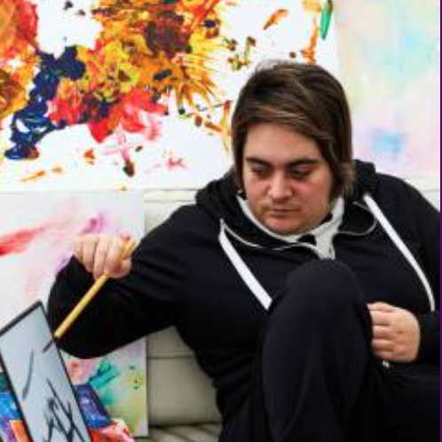
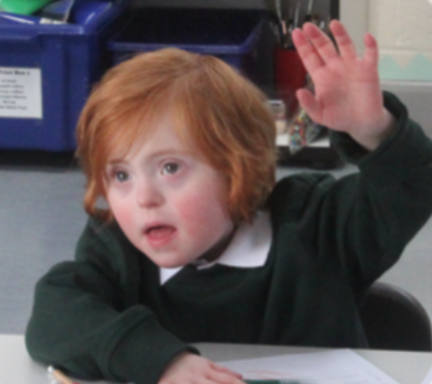
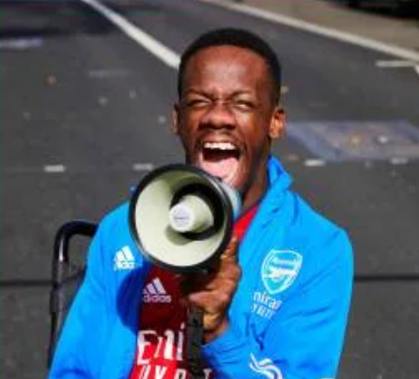
Don’t hold us back
Notes:
Stigma
Employment
Education

Slide 8
Don’t hold us back
For those of us who live with a learning disability, every day can be a battle. We have to fight to be seen. To be included. To get the things everyone should take for granted. Like a safe home, decent healthcare, the right support at school and the chance to get a job we can do well. We deserve better – and we’ve been held back long enough.
So - with Mencap - we’re building a movement to knock down the barriers that stop us living our very best lives. We’re calling out the people and attitudes that stop us being who we know we can be. There’s so much more we want to do - for ourselves and for others.
If you’re with us, don’t hold back – get involved today. We’re breaking through what holds us back. Because the days of us being overlooked are over.
Notes:
Don't hold us back: Fundraising / specific campaign framing
Homes not hospitals: We should not be locked up against our wishes in secure units. We should be free - and supported - to live in the community in our own safe homes.
Health care: We want to live our best lives in the best possible health. But the health system isn't making this easy. Too often, our needs are overlooked and our wishes - and the very best care - are denied us.
Social care:

Slide 9
Don’t hold us back …
It is not OK to lock us up in secure units against our wishes. It is not OK to restrain and isolate us. We should be free - and supported - to live in our own safe homes and near our families.
We want to live our best lives in the best possible health. But the health system is holding us back. Too often, our needs are overlooked, our wishes ignored and treatments even denied us. And some people die needlessly as a result. We deserve – and demand – the very best healthcare. Starting now.
Notes:
Don't hold us back: Fundraising / specific campaign framing
Don’t hold us back by locking us up in secure units. We want/demand our own, safe homes in the heart of the community, where we can be free and show our true potential to the world. It’s not too much to expect.
Don’t hold us back by forcing us to fight for fair, humane healthcare. We want/demand doctors who recognise who we are and what will help us thrive, instead of ignoring our wishes. It’s not too much to expect.
Homes not hospitals: We should not be locked up against our wishes in secure units. We should be free - and supported - to live in our own safe homes.
Health care: We want to live our best lives in the best possible health. But the health system isn't making this easy. Too often, our needs are overlooked and our wishes - and the very best care - are denied us.
Social care:
Every one of us locked up against our will in secure units is held back every day. There are xx,xxx of us in secure units in the UK – which should be a national scandal. People with a learning disability should be free – and supported – to live in our own safe homes.
The health system holds people with a learning disability back every day. It overlooks us. It ignores us. It denies us the treatments we need – and people die needlessly as a result. We deserve – and demand – the very best care. Starting now.

Slide 10
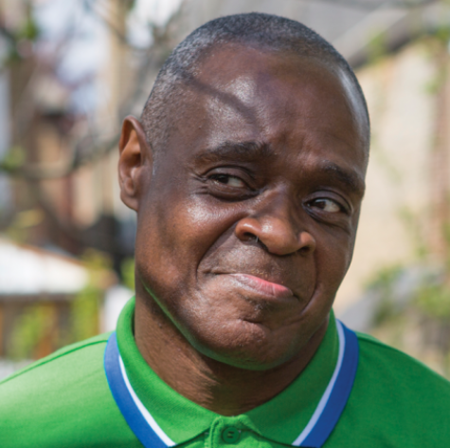
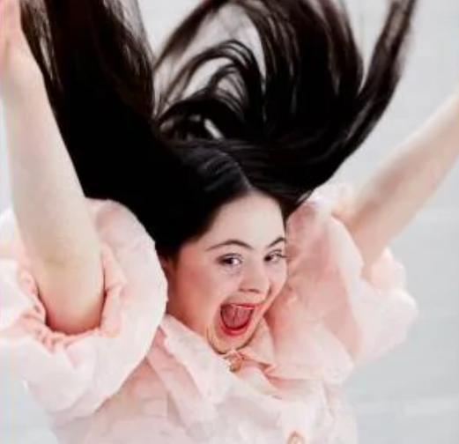
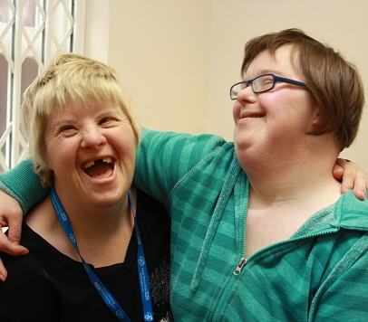
We are whole and human

Slide 11
We are whole and human
Everyday, people label us, mock us, patronise us. People assume we’re incapable of making decisions. Of caring for others. Of having opinions worth listening to. Some people think it’s ok to mistreat us.
But you know what? We’re not broken. We’re fully human. We’re equal. We have cares and fears, passions, hopes and dreams. And - with Mencap - we’re fighting together for our whole selves and our human rights to be recognised. We want to be safe from bullying. To have a home. To get a job. To get fair healthcare. To make a difference.
We’re fighting for respect, understanding and the chance to make our dreams come true. We’re here. We’re whole. We’re human. And we’re ready to be treated - and to treat others - with humankindness and compassion.

Slide 12
We are whole and human …
It’s inhumane to lock us away in secure units. Our dignity and freedoms taken away. Our wishes denied. It has to stop. We want to live - and be supported - in our own, safe homes. Starting now.
No health system should treat anyone like they are worth less. But that’s exactly what's happening to people with a learning disability. Instead of being treated as whole and human, we’re overlooked. Misunderstood. Even denied treatments. And people die as a result. This has to stop. We are no less worthy of the best possible care. The health system has to change.
Notes:
Whole and human: fundraising / specific campaign framing
Homes not hospitals: It is scandalous that people with a learning disability are being locked away in secure units. Their freedoms and wishes denied. This treatment is undignified. It’s inhumane. It has to stop.
Health: It is outrageous that people with a learning disability are not being given the same level of health care as others and some are dying needlessly. We’re no less worthy of the best possible treatments. We’re human too. We demand better.
It’s inhumane to lock people with a learning disability away in secure units. That’s not how you treat anyone as whole or human. Our wishes are denied. Our dignity and freedoms are taken away. And it has to stop. We want to live and be supported in our own, safe homes. Starting now.
No health system should treat anyone like they are worth less. But that’s exactly what our health system does to people with a learning disability. Instead of being treated as whole and human, we’re denied treatments. We’re overlooked. We’re treated like second-class citizens. And people die as a result. This has to stop. We’re human too. We no less worthy of the best possible treatments. The health system has to change.

Slide 13
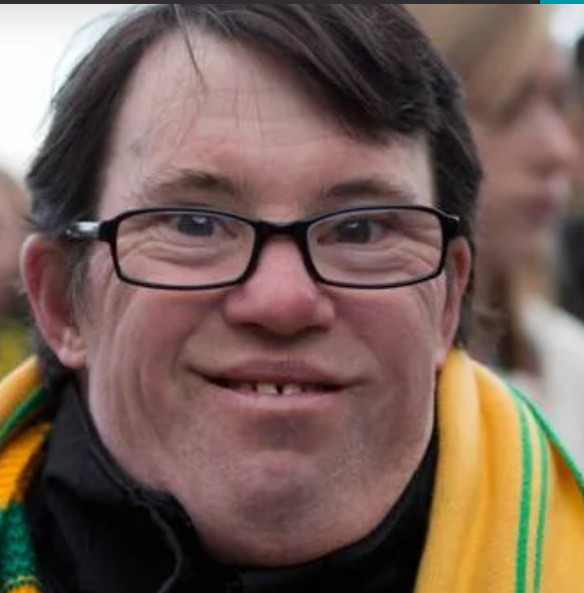
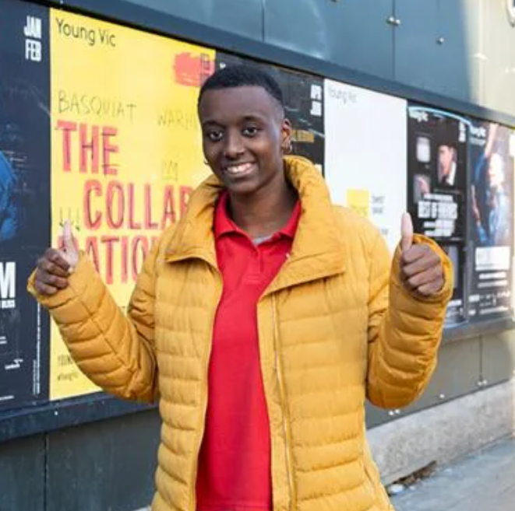
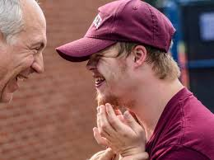
Do you see me?
Notes:
Stigma
Education
Employment

Slide 14
Do you see me?
When you look at me, what do you see? Do you see a learning disability or do you see me? The real, whole me. With talents. Dreams. Potential.
People with a learning disability have had enough of being ignored and mistreated. Of being judged and patronised. We’ve had enough of services that ignore us, instead of supporting us. We’ve had enough of schools and workplaces that don’t include us – and let our potential be wasted. And we’ve had enough of people who mock or bully us – unaware of how it makes us feel.
We – and Mencap – want people with a learning disability to be seen. We want to be recognised for who we are. People with feelings, specific needs and a whole lot to give. The world will be a better, fairer, happier place if we are all truly seen.
Notes:
Do you see me? Fundraising / specific campaign framing
Homes not hospitals: We don’t want to be hidden and locked away in secure units. We want to live in our own safe homes. It is scandalous that even today, people with a learning disability are being treated so appallingly behind closed doors.
Health: We don’t want to be overlooked and mistreated in hospitals. We want fair healthcare that recognises us and our needs and stops the avoidable deaths.

Slide 15
Do you see me? …
We don’t want to be hidden and locked away in secure units. Our rights and freedoms denied us. It’s a scandal that people with a learning disability were ever treated in this way - behind closed doors - and it has to stop now. We refuse to stay invisible. We demand to live in our own safe homes.
We must not be overlooked and mistreated in hospitals. We need a health system that sees us, listens to us, recognises what we need and treats us without prejudice. We’re done with feeling invisible and the avoidable deaths must stop.
Notes:
Do you see me? Fundraising / specific campaign framing
Homes not hospitals: We don’t want to be hidden and locked away in secure units. We want to live in our own safe homes. It is scandalous that even today, people with a learning disability are being treated so appallingly behind closed doors.
Health: We don’t want to be overlooked and mistreated in hospitals. We want fair healthcare that recognises us and our needs and equal treatment to stop the avoidable deaths.
How can our health system refuse to see us for who we really are? How can doctors deny us the best treatments? How can we be ignored and overlooked? How can people with a learning disability continue to die needlessly? We’ve been treated as invisible for too long. It’s time to see a better future. Right now.

Slide 16
Three ideas
Don’t hold us back
We are whole and human
Do you see me?

Slide 17
Process / next steps

Slide 18
Timeline
W/c 22nd May
W/c 29th May
W/c 5th June
W/c 12th June
W/c 19th June
W/c 26th June
Present to SMT (and shortlist to two routes)
Testing/consultation (PWLD workshop, campaigns team, fundraising team, staff drop in)
SMT decision on final route, develop narrative, plan activation workshops
Feedback on/ finalisation of narrative
Activation workshops
Activation workshops and output written up
Notes:
First - Paul (client) feedback on 3 options

Slide 19
Process
Shortlisting to 2:
Fundraising asap - call
SMT - call
Consulting on / developing options:
Campaigns Team - call
Fundraising Team - call
PWLD: Workshop Group - workshop
Family & Carers - email
Staff from workshops & interviews - drop in or email?
Informing final decision:
Externals - email from Paul
Wider staff team - email and invite to activation workshop
Include Me Group - on next meeting
Notes:
First - Paul (client) feedback on 3 options

