Slide 1
MENCAP
Stephen Thorn
June 2022

Slide 3
Welcome: Introduction
Welcome to today’s session

Slide 4
Welcome: Agenda
Objectives shared in the opening communication to Network Partners:
Using data, information and knowledge for growth and impact to:
  Choose and prioritise your income streams.
  Create or refresh your Case for Support.
  Chart supporter journeys.
  Develop new stories and case studies.
  Provide a framework for marketing, fundraising and comms plans.

Slide 5
Welcome: Introduction
Stephen Thorn has worked as a Senior Executive, Director and Board Member of commercial and nonprofit organisations where he has been responsible for marketing, fundraising, and business development functions. Over the last ten years he has developed a specialist focus on not-for-profit and charity sector strategic business planning, organisational design, and sustainable impact solutions.
He has served as the Sales & Marketing Director of Woodmansterne Publications, Fundraising Director and Interim CEO for international street children’s charity Toybox, and is a Preferred Supplier to the City Bridge Trust. He was a consultant and then founding executive of the EY (previously Ernst & Young) Foundation which supports disadvantaged young people into the workplace, where as Head of Business Development, Communications and External Relations he established a £multi-million fundraising operation from scratch.
A Postgraduate (DipM) and Member of the Chartered Institute of Marketing (MCIM), Stephen also has an MSc in NGO Management and is an alumnus of the INSEAD Social Enterprise Programme (ISEP). He was previously the Chair of Trustees of Big Picture Learning UK. Recent clients have included business development strategy for international humanitarian initiative Response Innovation Lab, marketing and fundraising strategy and planning for the Cranfield Trust, performance management consultancy for Children and Families Across Borders and organisational development benchmarking and strategic recommendations for Versus Arthritis and the Samaritans.

Slide 6
Using data, information and knowledge for growth and impact
Bayes Business School (formerly Cass)

Slide 7
Using data, information and knowledge for growth and impact
Why is data collection important?
What data have you got?
What might the data be useful for?
Who might know where your data is?
Who might help you collect data in future?
Who might be the people that you have collected data on?
Where might it be?
How might you extract the data? Store it?
When might you collect data in future? Every day? Week? Month? Quarter? Year?

Slide 8
Using data, information and knowledge for growth and impact
What types of people and organisations might you be collecting data about?
Service Users
Service user data: the number of people engaging with a service or initiative, and their age, gender, etc.
Engagement data: how frequently or how long they use a service or initiative.
Outcome data: the benefits users get from a service intervention, or the funds raised from a campaign.
Impact data: the long-term benefits or changes users get after an intervention.

Slide 9
Using data, information and knowledge for growth and impact
Supporters
Donor data: contact frequency, donation amount, age, gender, income, location, etc. (RFVC – Recency, Frequency, Value, Channel)
Other Stakeholders
Professional funding organisations: the detail of existing and prospective funders: statutory, trusts and foundations.
Volunteers.
Trustees.
Strategic Partners.
Internal Sources
Financial, Reporting, Other.

Slide 10
Using data, information and knowledge for growth and impact
“…internal frustrations of more than 500 non-profit finance leaders, most of which relate to the inability to see or monitor their metrics. Delays due to disparate systems, lack of real-time visibility into key metrics, and an inability to measure their outcome metrics all entered into the top five challenges that nonprofits face.”
Sage Survey (Charity Digital article)

Slide 11
Homework #1
Conduct a data mapping exercise.
  Write to the whole team and say,
  ”Following some recent consultancy advice from Bayes Centre for Charity Effectiveness, I’m conducting a data mapping exercise to see what data and information we hold on our systems. Once I know what we’re currently gathering it will help me to understand how we might gather and store it more efficiently and then use the data to help growth our income, engage our supporters, enthuse our funders (and attract new ones) and power our marketing and communications activity.
  Therefore, it would be hugely appreciated if you could let me know what data you are gathering, who the data is about, and how it is stored. It would great to know if you feel that we are not using the information to our best advantage. I’d also be very happy to sit with you and for you to show me in person or shared screen if that is easier for you.”

Slide 12
Choose and prioritise income streams
Bayes Business School (formerly Cass)

Slide 13
Using data, information and knowledge for growth and impact
Income Stream Data
Internal
Donor data: contact frequency, donation amount, age, gender, income, location, etc. (RFVC – Recency, Frequency, Value, Channel).
Professional funding organisations: the detail of existing and prospective funders: statutory, trusts and foundations, enterprise activity What is the history of income? What is the potential?
External
How are other similar organisations being funded? What are the trends?
What information is available to figure out the ROI potential in seeking other funding opportunities?

Slide 14
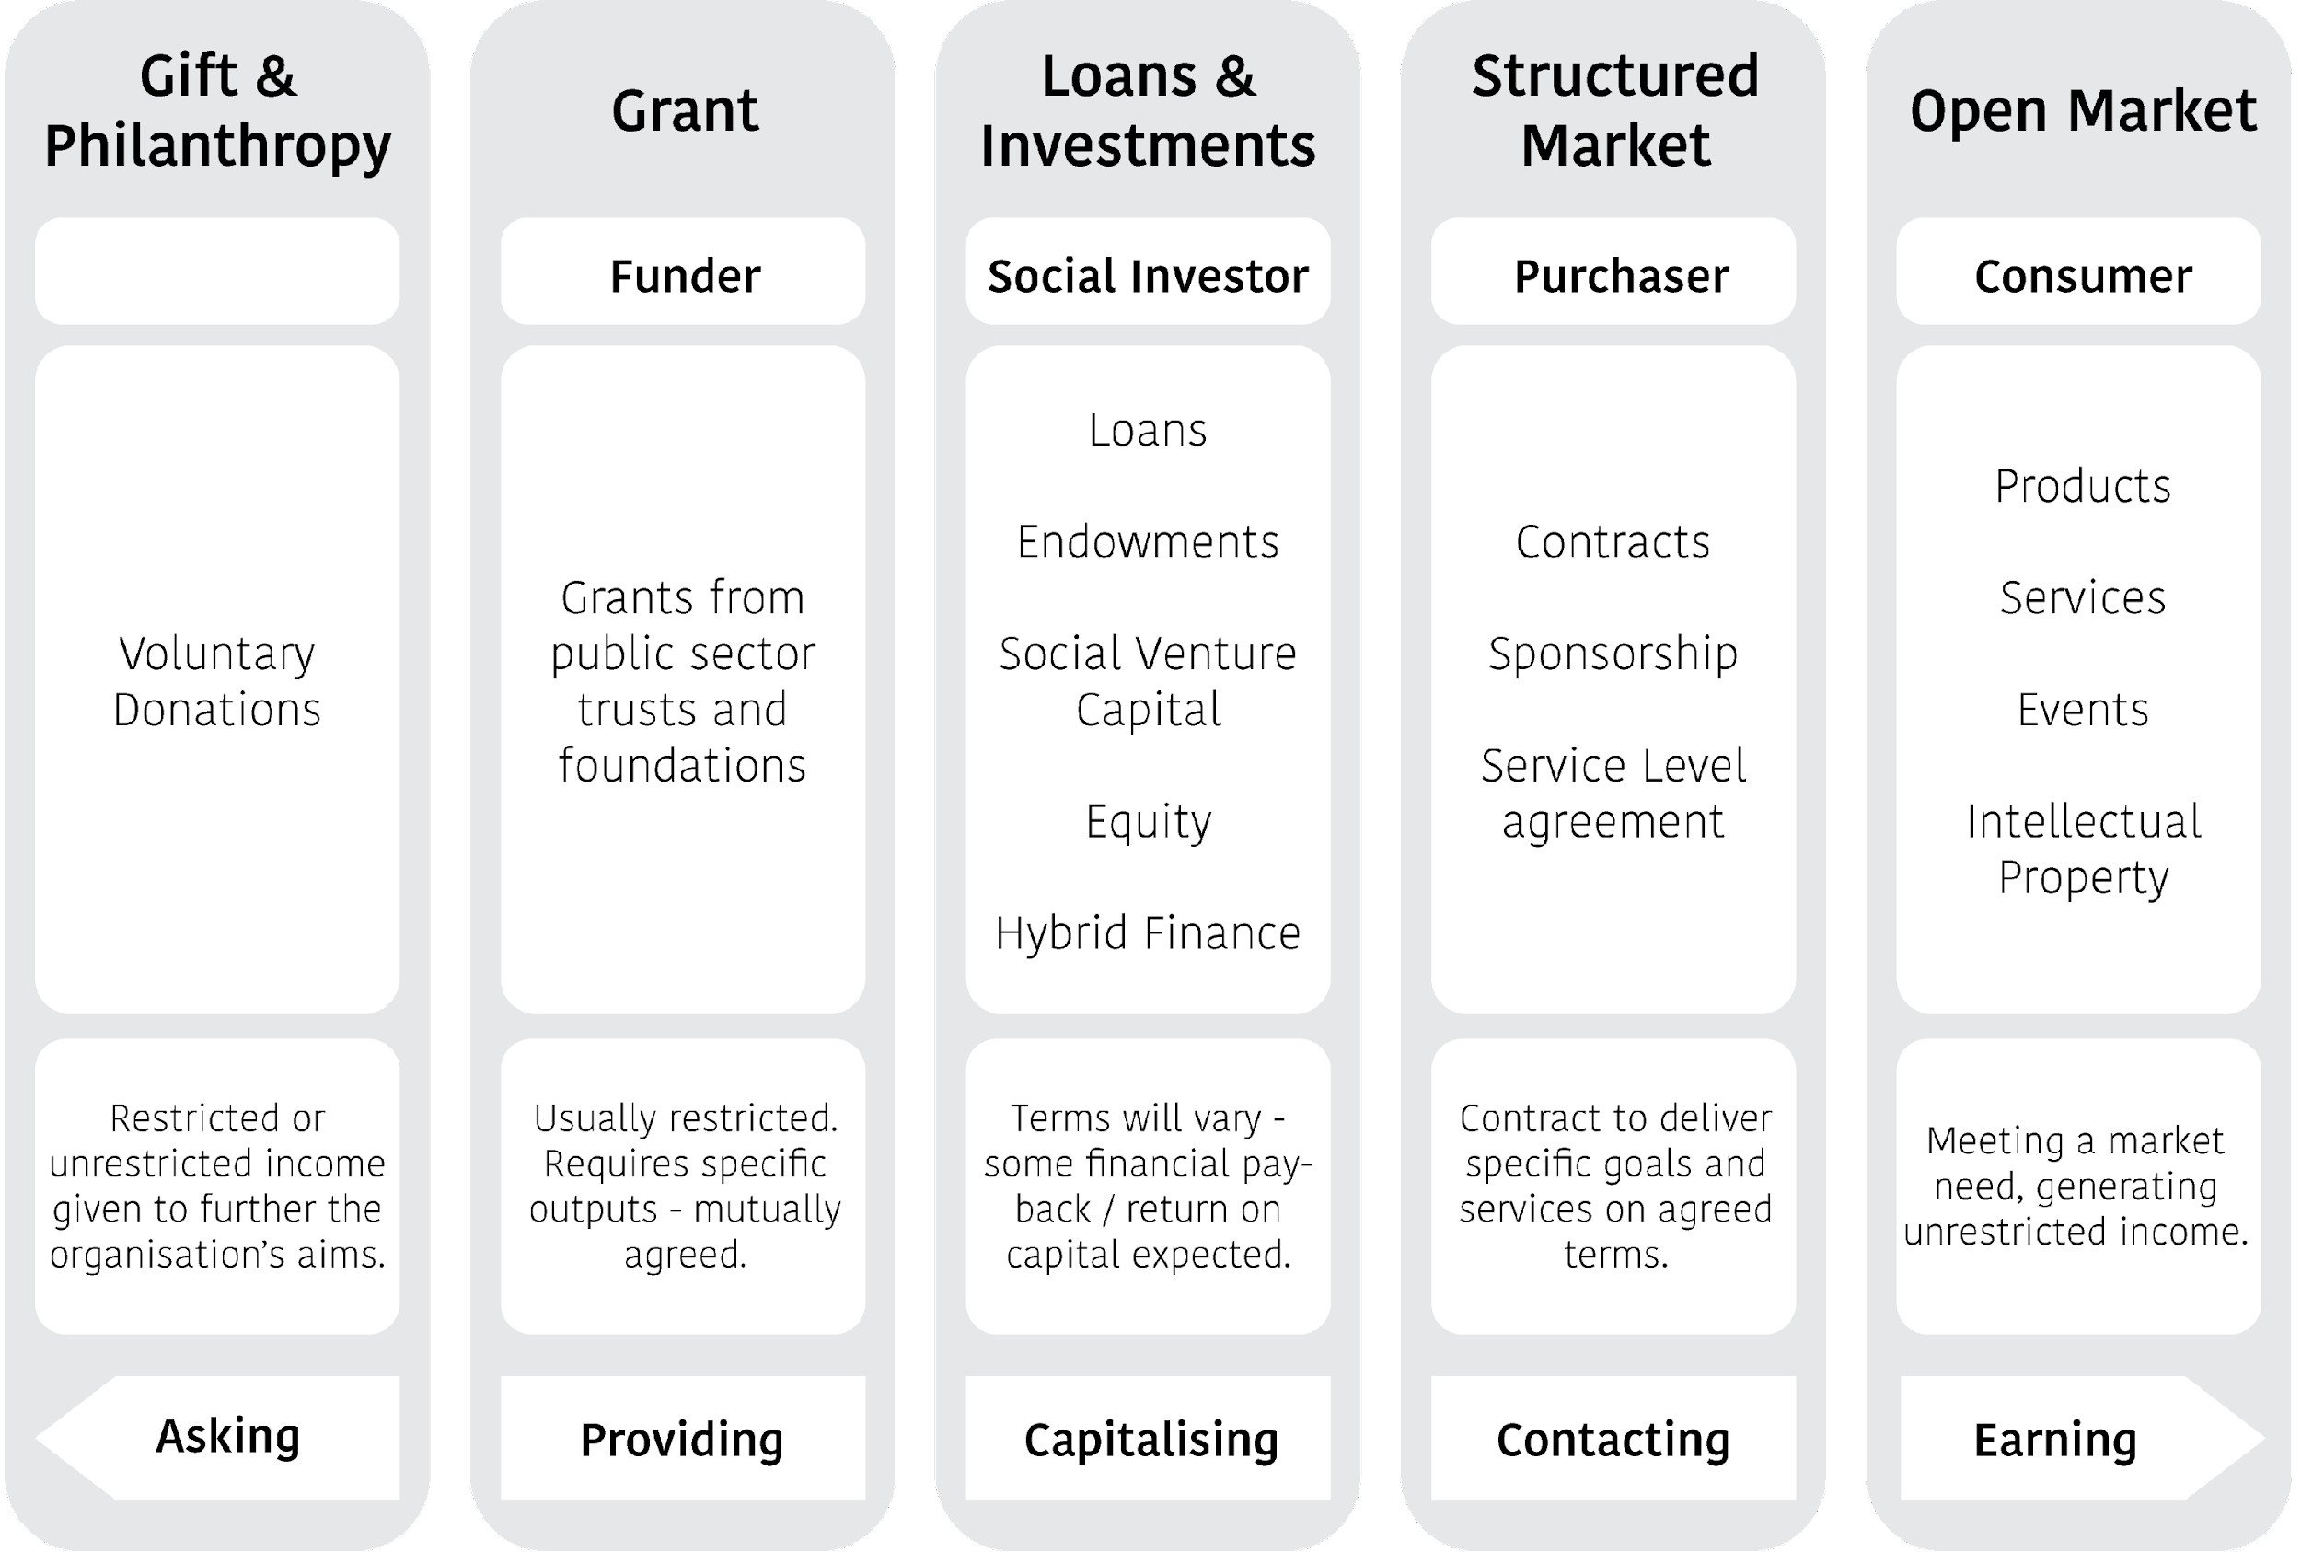
Choose and prioritise income streams
Individual
Community
Events
Corporate
Gift Aid

Slide 15
Spectrum on income streams available
Gift / Philanthropy
Individual donations
  One-off and appeals
  Regular giving
  Major donors
  Legacies
Community fundraising
  Local clubs and societies
  Business in the community
  School and colleges
Events
  Sponsored events
  Collections
  Raffles & lotteries
  Celebrities
Corporate (companies)

Slide 16
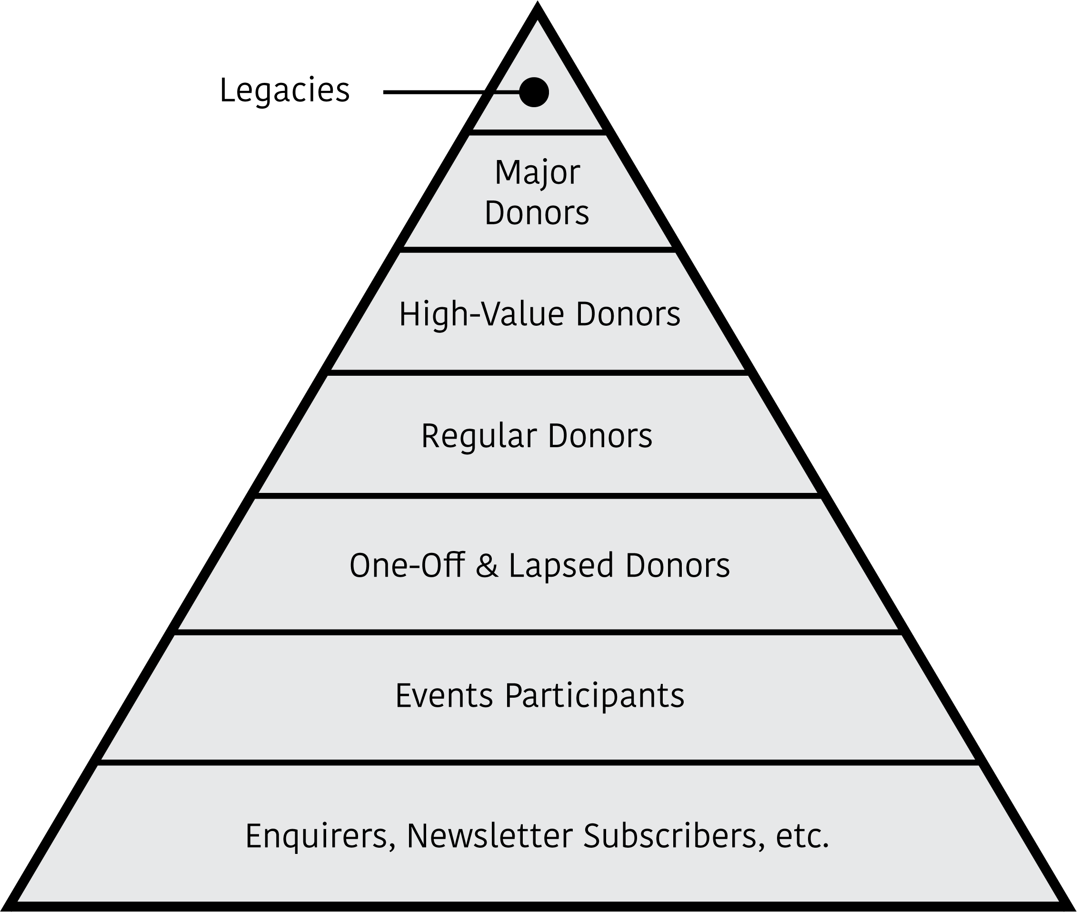
Choosing, prioritising income streams
Where has income come from to date?
  Can you build on that?
  Recency, Frequency, Value, Channel?
  Donor pyramid (see diagram)
What are the other income options?
  Where are other organisations raising money?
  Check out the Charity Commission, their social media feeds
  Access all the free resources – 360 Giving, NFP Research, etc
Can you think how you might trial new income activity?
  Volunteer-led?
  In partnership?
  ‘Lockstep’ investment?

Slide 17
Homework #2
Get a small group together (it might be just two of you; one of them might be your aunt) to discuss data and information for income generation. Bring doughnuts and coffee.
  Based on the data mapping exercise what have you got?
  What is missing?
  How might you get what is missing?
  What Actions do you need to do to get moving?

Slide 18
Homework #2
Get a small group together (it might be just two of you; one of them might be your Mum) to discuss data and information for income generation. Bring doughnuts and coffee.
  Based on the data mapping exercise what have you got?
  What is missing?
  How might you get what is missing?
  What Actions do you need to do to get moving?

Slide 19
Create or refresh your Case for Support
Bayes Business School (formerly Cass)

Slide 20
Create or refresh your Case for Support
A Case for Support is a short (two page) document that seeks to make the case for why supporters should get involved with your organisation and what value you can give in return for their engagement.
Key headers for a Case of Support:
Who are we?
Working together we can…
People support us because…
We respond to our supporters' motivations by…
How can you support us?
What do you, as a supporter, get for your time, money, and resources?
Further information: https://www.hodwell.co.uk/post/six-brilliant-headers-for-a-case-for-support

Slide 21
Create or refresh your Case for Support
Who are we?
<Our Organisation> is a unique, rapidly growing and award-winning charity that was set up in 2002, providing support to autistic children and young people, and also to their families.
We run social clubs, specialist trampolining and technology projects, holiday programmes, and residential trips that all focus on enabling our young people to access what they are entitled to - fun, friendship and an independent future. Our families can access advice, information and support, as well as be able to form valuable friendships with each other.
We are based in the <our place> and currently work with around 300 children and young people every week in various venues across the borough.

Slide 22
Create or refresh your Case for Support
Working together we can…
At <our organisation> support for others is foundational to what we do. As such, your support allows us to continue providing vital services to children and young people (as well as their families). Tangibly, this manifests as a suite of activities including; <Activity 1>, <Activity 2> and <Activity 3>. Thus, with your support we’re able to provide inspirational activities and opportunities for children and young people. The latter is particularly important with activities offering those an opportunity to develop social, communication and independent living skills as well as allowing them to gain confidence and increase their chances of full integration into society.
In addition to our current offering, your involvement offers an opportunity to increase our impact, thereby empowering children and young people to be proud of who they are. Specifically, with your support we can expand upon existing services, offering assistance to adults and supporting parents/ families of children and young people. Your involvement enables this support and allows <our organisation> to get positively involved with children, young people and their families.

Slide 23
Create or refresh your Case for Support
People support us because…
There are a wide range of reasons as to why to support <our organisation>, however, typically this stems from an interest in supporting activities otherwise unavailable to children and young people with autism. In addition to this, supporters are keen to provide <our organisation> with the tools to quickly respond to societal challenges and (i.e. Coronavirus), thus providing <our organisation> with the motivation to continue making life for autistic children/ young people and their families better.
Beyond supporting the interests of <our organisation>, many supporters know/ have experience of the impact volunteering can have thus are keen to offer their time to help <our organisation> build a stronger base and add capacity to its existing/ developing service provision.
Finally, many choose to support <our organisation> as a function of personal experience (i.e. a member of their family or even themselves has autism). As such they recognise <our organisation> to be well supported to offer the kind of support they themselves (or someone they know) would have benefited from.
Notes:
>

Slide 24
Create or refresh your Case for Support
We respond to our supporters' motivations by…
In terms of <our organisation’s> engagement with supporters, those who engage can rest assured that <our organisation> will clearly communicate its activities on the ground through photography, written updates, stories, videos and case studies.
Furthermore, through our social media presence we will engage in discussions and debate with supporters, answer questions, share updates relating to work and opportunities and provide sign-posting to other opportunities, stories and resources that might be of interest and practice use to those motivated to support us.

Slide 25
Create or refresh your Case for Support
How can you support us?
<Our organisation> always appreciates support that is offered, be that a donation, a plan for a fundraising event, individuals volunteering their time and business supporters.
Foremost you can support <our organisation> financially by making a one-off donation, giving small, regular contributions or through a planned fundraising event. Any donation is most welcome and <our organisation> always endeavours to support those that give. In addition to individual giving, <our organisation> welcomes any support that businesses can provide and we’re happy to provide assistance and further information for those interested in this.
Just as significant as giving is the support you’re able to offer in the form of time as a volunteer. <Our organisation> relies on volunteers to support its activities and community, thus any support and time you’re able to offer is most welcome.

Slide 26
Create or refresh your Case for Support
What do you, as a supporter, get for your time, money, and resources?
While there is no tangible return to supporters, in the form of a supporter pack (a function of <our organisation> wanting to focus efforts on delivery) supporters gain the satisfaction of know that your support, no matter how large or small, financial, influencing or volunteering, in person or online, goes directly to supporting autistic children/ young people and their families. In doing this, you get the delight that comes with supporting an organisation that is at the forefront of offering inspirational activities and opportunities for children and young people with autism.

Slide 27
Homework #3
Write a Case for Support
  Does the organisation, or one of the branches, already have one?
  Can you make it really local, and thus really engaging?
  What existing information can you use?
  What information would be good to include if you had it?
  How can you go about finding the information that would make it better?

Slide 28
Chart supporter journeys
Bayes Business School (formerly Cass)

Slide 29
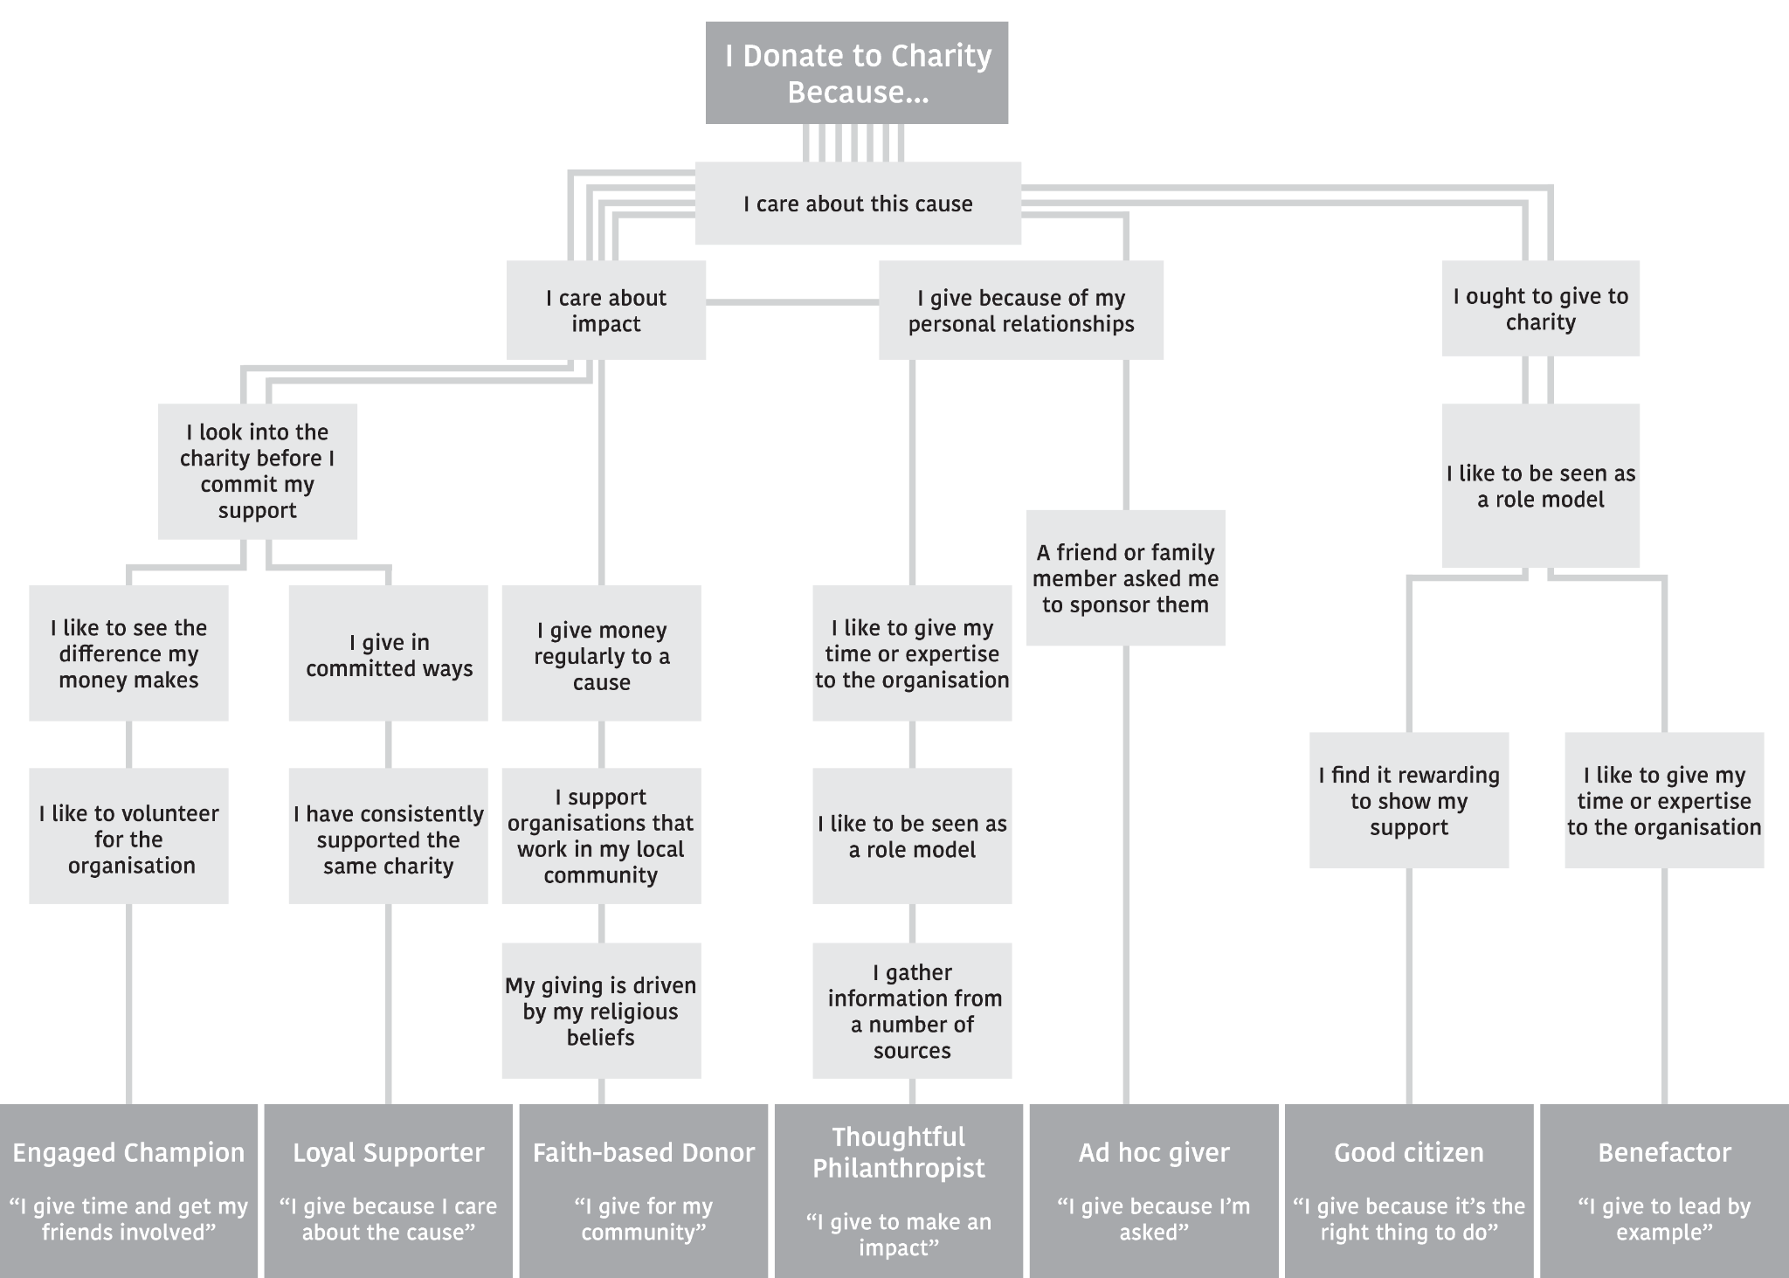

Slide 30
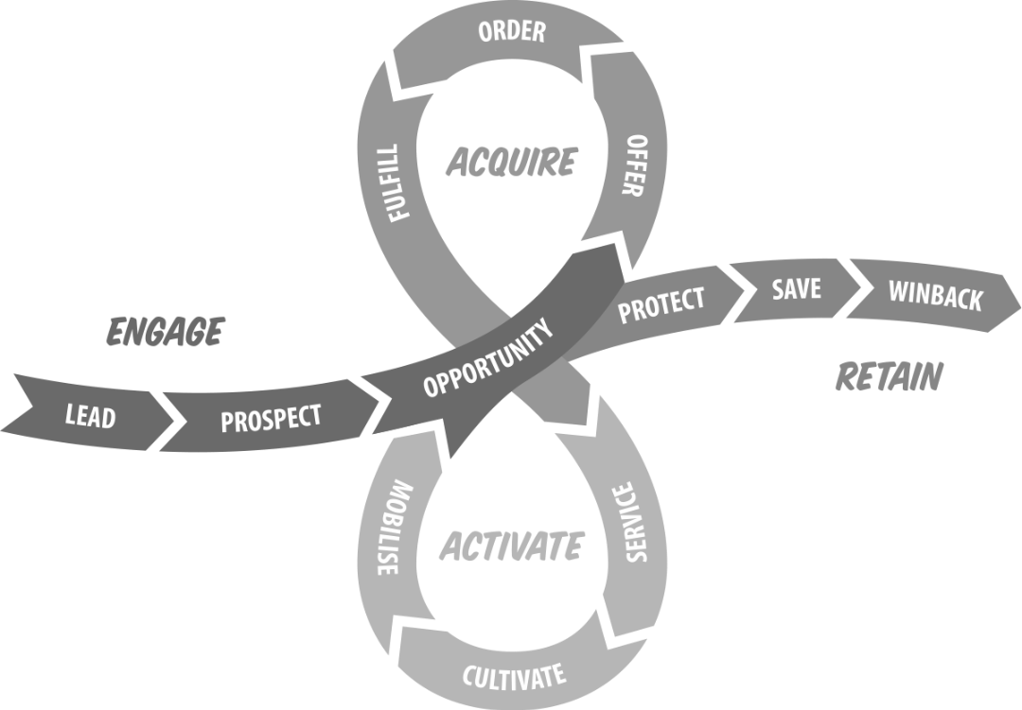
Source: Clarety

Slide 31
Love Story Grid
 | Week 1 | Week 1 - 2 | Week 4 | 2nd Month | 3rd Month | 4th Month | 5th Month | 6th Month
Objective | Welcome! | Thank you & receipt | Getting to know each other | Surprise and delight | Ask, highly variable | Action | Surprise and delight | Demonstrate impact
What is it?
Feeling | Sincere, happy, friendly | Transparent accountable | This is a dialogue, a relationship | Wow! Amazing! | I can see how my gift will make a difference | This is great! I can do more than just give. | Wow! Amazing! | Proud to be part of this.
Metrics
Source: SOFII
Clarety

Slide 32

Showcase Of Fundraising Innovation and Inspiration

Slide 33
Homework #4
Track a supporter journey. Build on that over time.
  What data and information do you have that will help? (Google Analytics etc).
  Start by ’mocking up’ your idea of a typical supporter journey.
  Test your idea with real supporters and other stakeholders.
  Create ’types’ or ‘personas’ to help create future journeys.
  Use personas in your marketing and communication planning.

Slide 34
Develop new stories and case studies
Bayes Business School (formerly Cass)

Slide 35
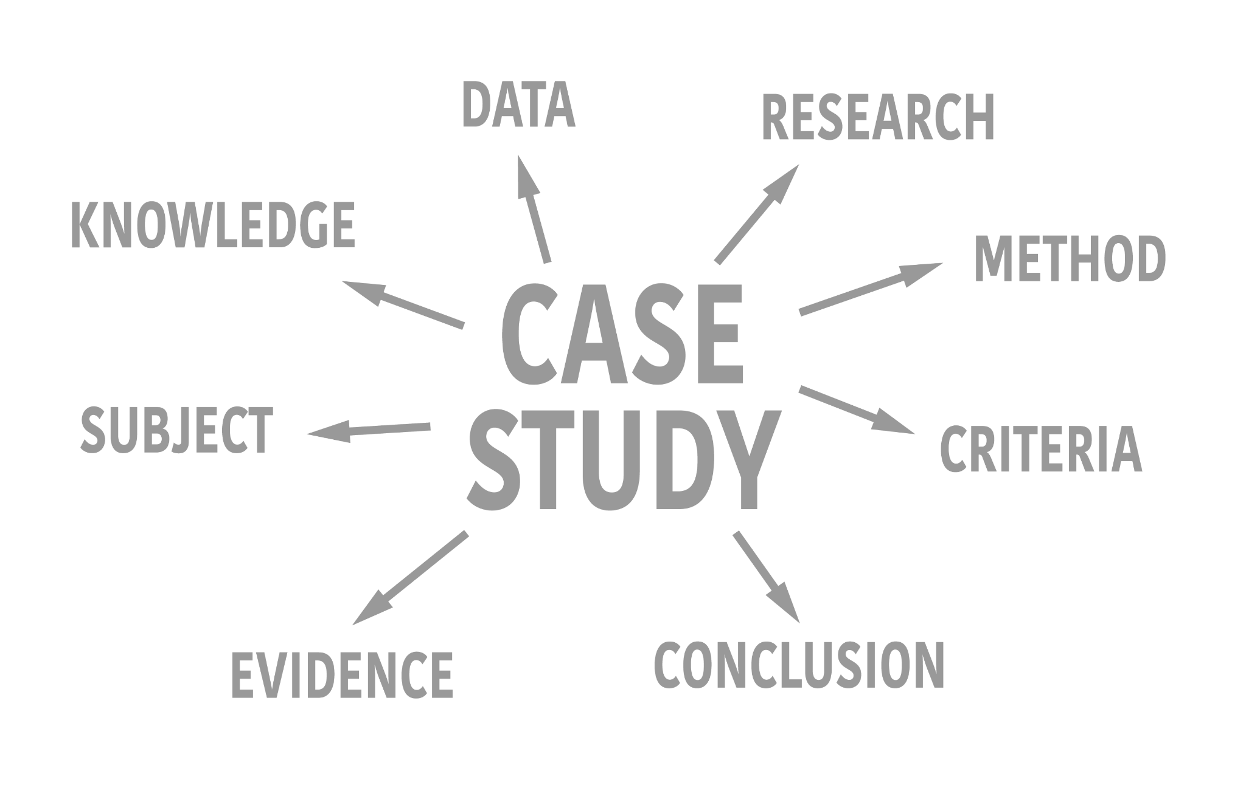
Develop new stories and case studies
My recommended key headers for a case study:
Background
Challenge
Solution
Impact
Examples: https://www.hodwell.co.uk/clients

Slide 36
Develop new stories and case studies (example)
Beyond: Launch preparation for a new high-profile UK mental health charity
Background: Jonny Benjamin MBE is a British mental health campaigner, author and vlogger. In January 2014 he launched a social media campaign called Find 'Mike' to search for a stranger who had talked him out of taking his own life in 2008. The purpose of the campaign was to raise awareness of suicide and mental illness and was successful in finding Neil Laybourn who was the ‘stranger’. Jonny and Neil decided to launch a new mental health charity together based on the campaign and their subsequent friendship. Hodwell Associates was approached by the launch Director to support her, the founders, and potential Trustees of this new high-profile organisation in preparation for a planned launch.
Challenge: The Director of the charity had already brought together some key structural documents including the safeguarding policy, constitution, business plan and mental health collective charter. However, there were some leading questions that needed answering as to the mission, vision and Theory of Change at the heart of the new operation. For example, why it was felt that the new charity was needed, and what it could do that others were not doing currently. What activity would the founders and Trustee like to see the charity delivering, and to whom and how. And what outcomes could the stakeholders envision being delivered in the first year, in five and in twenty years.

Slide 37
Develop new stories and case studies (example)
Solution: Hodwell Associates facilitated a pre-launch Board meeting where we discussed issues of governance, management and then workshopped a Theory of Change model. This led to a further debate about how the resultant outcomes pathway would facilitate the creation of the Case for Support and Development Strategy. Hodwell Associates worked with the charity team at all levels to explore an initial fundraising strategy, advising on team structure and developing key areas of initial focus. We provided ongoing support and consultancy for the Director of the charity advising on issues including strategy, governance and structure.
Impact: Following the Board meeting the Director wrote “Thanks so much for all your help on the charity and for us personally. Really appreciate all your wise counsel and your involvement is really vital in helping us move on”. The charity had a successful launch and has recently announced the creation of the UK’s first directory for children and young people’s mental health and wellness providers. For more information about https://wearebeyond.org.uk/.

Slide 38
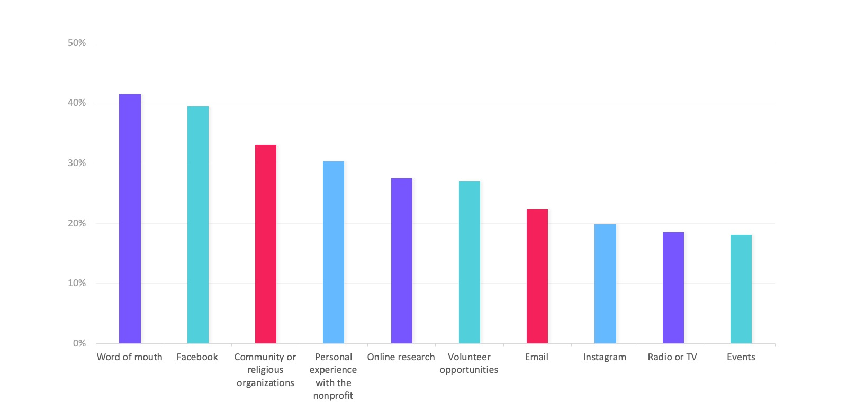
Develop new stories and case studies
Create supporter experiences to stand out from the crowd

Slide 39
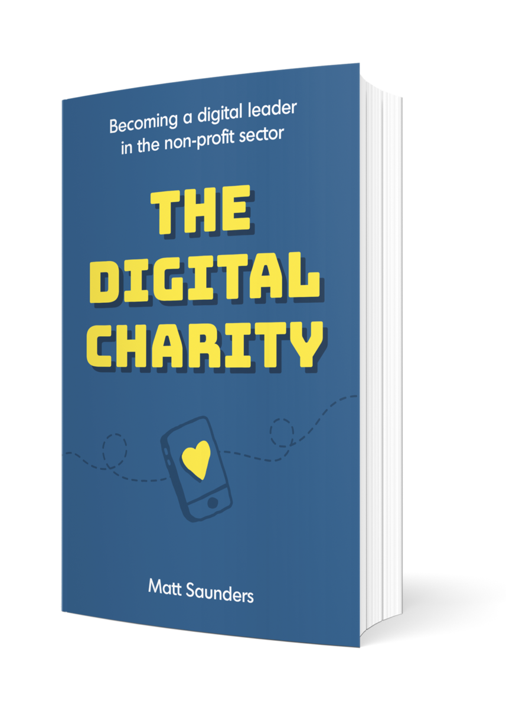

Develop new stories and case studies
Create supporter experiences to stand out from the crowd

Slide 40


Develop new stories and case studies
Create supporter experiences to stand out from the crowd

Slide 41
Homework #5
Create a couple of new Stories and Case Studies.
  Talk to everyone in your organisation – are there stories and case studies that have never been captured?
  Use the Case for Support to help figure which stories and case studies would inspire future supporters?
  Think about your media – many will be most enthused through photography and video.
  Use free resources for inspiration (www.cafonline.org/charities/fundraising/charity-stories).
  Use your Support Journey planning to plot when and where to deploy these resources?
  Set up an ‘Identify, Capture and Share’ process. Respect privacy. Celebrate and Thank people.
  Measure the response. This is easiest to do in the digital space (Views, Likes, Shares etc).

Slide 42
Provide a framework for marketing, fundraising and comms plans
Bayes Business School (formerly Cass)

Slide 43
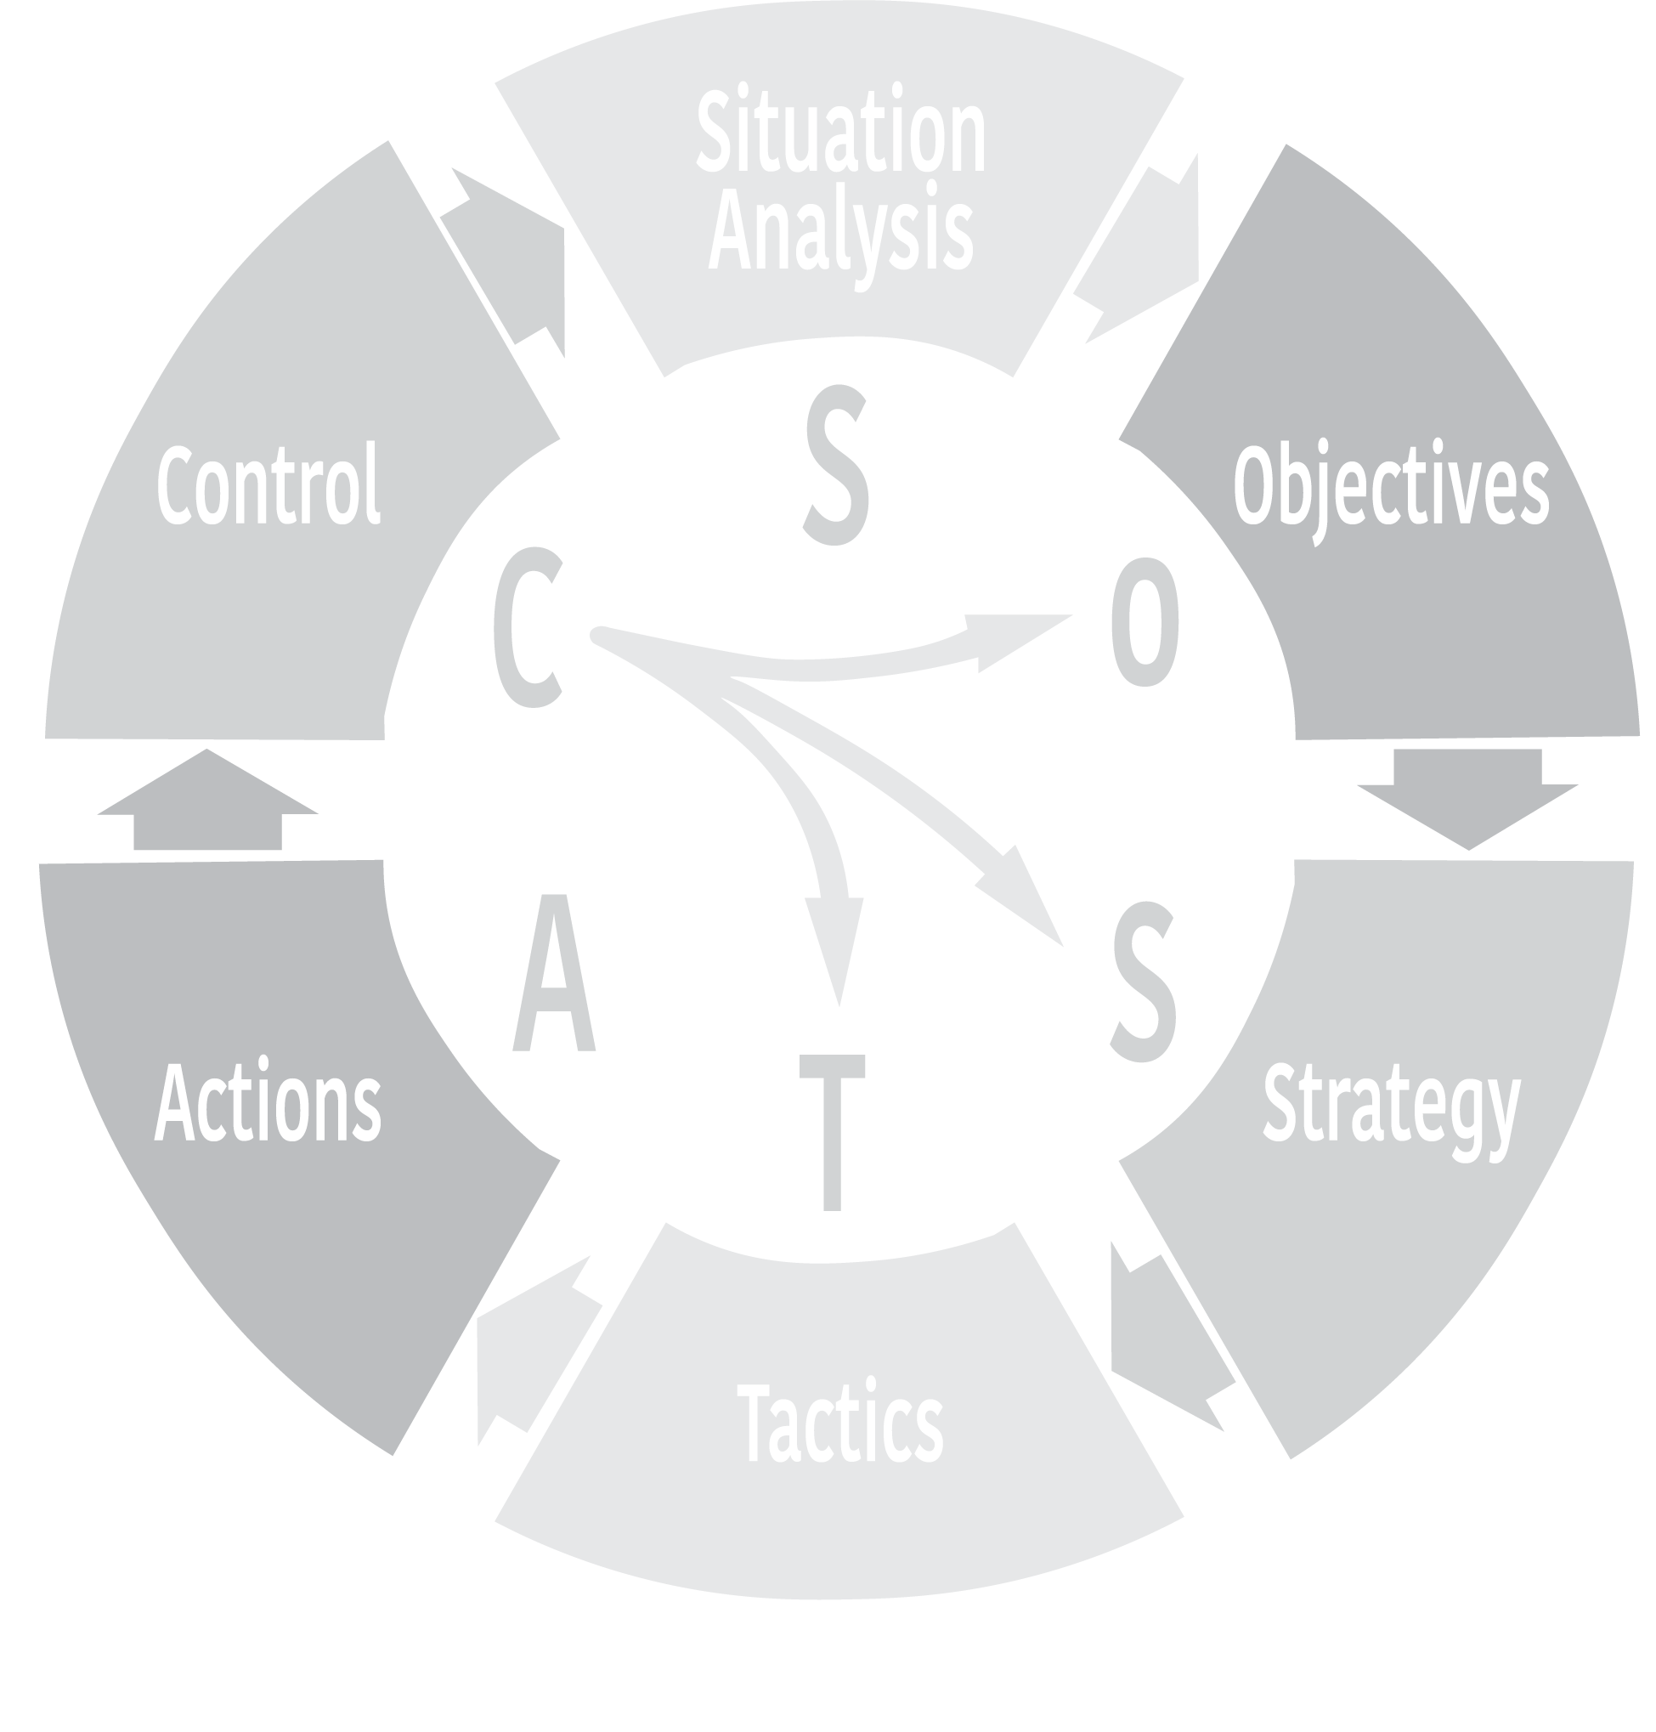
Provide a framework for marketing, fundraising and comms plans
Where are we now?
Where do we want to be?
How do we monitor performance?
How do we get there?
The details of the tactics
How exactly do we get there?

Slide 44
Provide a framework for marketing, fundraising and comms plans
Key headers for a great marketing, fundraising and comms plan, ideally set over three years:
Goals (marketing goals, fundraising goals, communications goals)
Messaging (Key Messaging, Case for Support)
Audiences (segmenting the charity’s stakeholders - personas)
Channels (Existing, New, include Digital (social media & website)
Resources (Timing, People, Budget)
Actions (prioritise, set critical paths, use Excel, Gantt, MS Project, Monday.com or Asana planning tools)
Resources (Timing, People, Budget)
Control (measuring achievement against Goals)

Slide 45
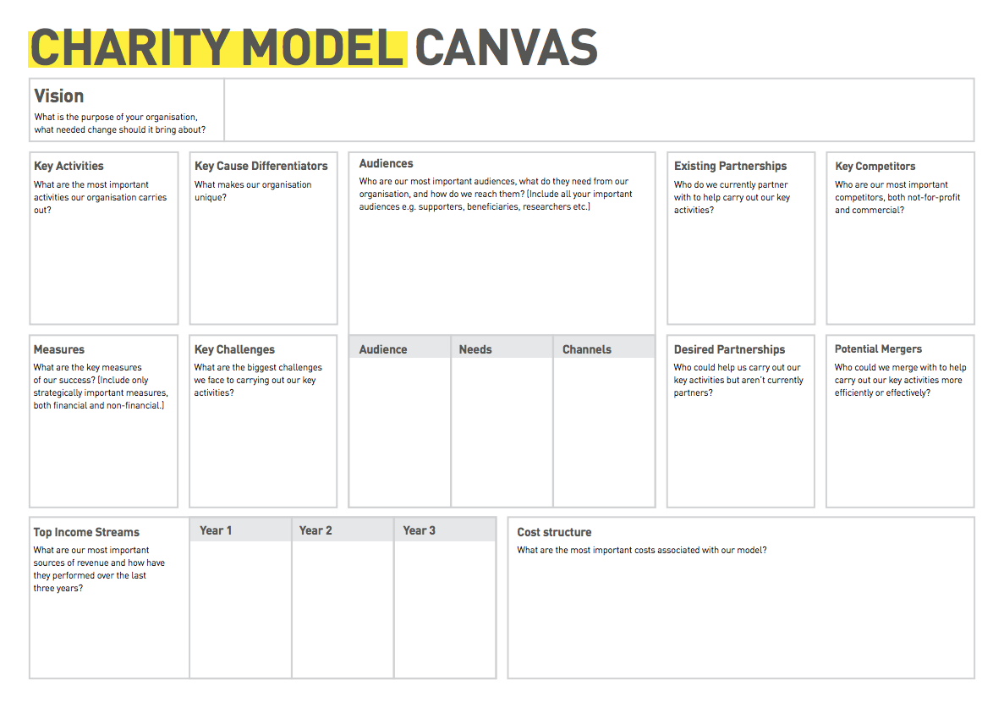

Slide 46
Homework #6
Write a simple fundraising, marketing and communications plan
  Don’t overcomplicate it.
  Start with the eight chapter headers provided.
  Use the data and information that you already have to get things started (baseline).
  Identify in the plan the data, information, knowledge and research you’ll need in future.
  Think about who may be able to help you – voluntary, paid or subsided resource. Perhaps a local and/or connected corporate could assist with a placement, secondment or internship?
  Use free frameworks, tools and templates.
  Ask if a non-competitive charity, perhaps someone in your network, would share there's with you.
  Drop in your work on supporter journeys, case for support, story capture and fundraising ideas into the plan.

Slide 47
Did we cover all the issues and questions?
Advance questions:
What makes a (grant application) bid really stand out?
  Match the eligibility criteria
  Use data and information to support your bid
  Incorporate innovation
  Include a strategic partnership if you are able
  Have someone read it from the POV of the funder
  Check it against a sensible checklist (https://www.resourcecentre.org.uk/information/writing-a-funding-application/)
Who are the best people to approach re: funding support?
  Existing funders
  Other connected stakeholders
  Those funding similar thematic organisations nationally
  Those funding other local organisations

Slide 48
Did we cover all the issues and questions?
Advance questions:
How can we effectively write and implement a Comms strategy without a marketing resource within the fundraising team?
  Buy a book (Make It Matter, Joe Barrell) and/or use online resources (CharityComms and NCVO).
  Find a volunteer with a professional comms background.
  Hire a consultant on a short-term contract.
  Use a ‘Funder Plus’ support organisation – Locality, Cranfield Trust, Rocket Science, other Trusts & Foundations.
  Use university-based resource organisations – Enactus etc.
What’s the priority income stream biggest Return On Investment?
  Legacy

Slide 49
Did we cover all the issues and questions?
Advance questions:
What is the biggest challenge to hitting, and sustaining, your income targets? [To spin that question around, how do you hit and sustain your income targets?]
  Planning, planning and planning.
  Research.
  Building Resources (including people and knowledge).
  Setting Targets (hard, soft, stretch).
  Making it everyone’s business.
  Weaving it into the business plan.
  Celebrating success.
Building a regular givers strategy sustaining regular givers?
  https://www.dsc.org.uk/wp-content/uploads/2016/09/Workshop-7-Individual-giving-Case-studies-for-developing-regular-giving.pdf

Slide 50
Did we cover all the issues and questions?
Advance questions:
Generating continuous cashflow?
  See everything discussed today (and keep the flywheel turning).
  Ensure best-practice financial management (Charity Finance Group)
Is it worth outsourcing some of this work?
  Possibly. Develop a clear brief for work that you are finding it hard to resource. Disseminate that information and see what comes back (social media especially LinkedIn, also Charity Connect, via Trustees, other stakeholders, connections and networks).
When to invest in a fundraising manger?
  Can you put a fundraising plan together first?
  Could you put a brief together for what is expected of a fundraiser?
  Can you bring in a consultant on a short-term contract to kick things off/ help develop an existing team member?

Slide 51
Did we cover all the issues and questions?
Advance questions:
Lack of strategy and knowledge on best practice.
  Hopefully sessions like today are useful.
  Sign-up to free resources (Bayes CCE, NCVO, Cranfield Trust etc)
  Keep reading. Listen to podcast. Attend events.
  Recruit Trustees and volunteers with useful professional skills.
Prioritising income streams whilst maintaining interest from those that have less £ value.
  Once the Case for Support and Supporter Journey mapping has been done ask what can be automated/deliver digitally? What can volunteers help manage? What other activity delivers most value to supporters most efficiently? Sometimes you will just have to prioritise and a balance must be struck.

Slide 52
Close: Thank you
Thanks for coming along to today’s session.

Slide 53
The Centre for Charity Effectiveness
Bayes Business School
(formerly Cass)
106 Bunhill Row
London EC1Y 8TZ
Bayes.city.ac.uk/cce
@BayesCCE

