Slide 1
JOIN IN THE FUN THIS JUNE WITH LEARNING DISABILITY WEEK

Slide 2
LEARNING DISABILITY WEEK IS HERE
Our school will be supporting Mencap

Slide 3
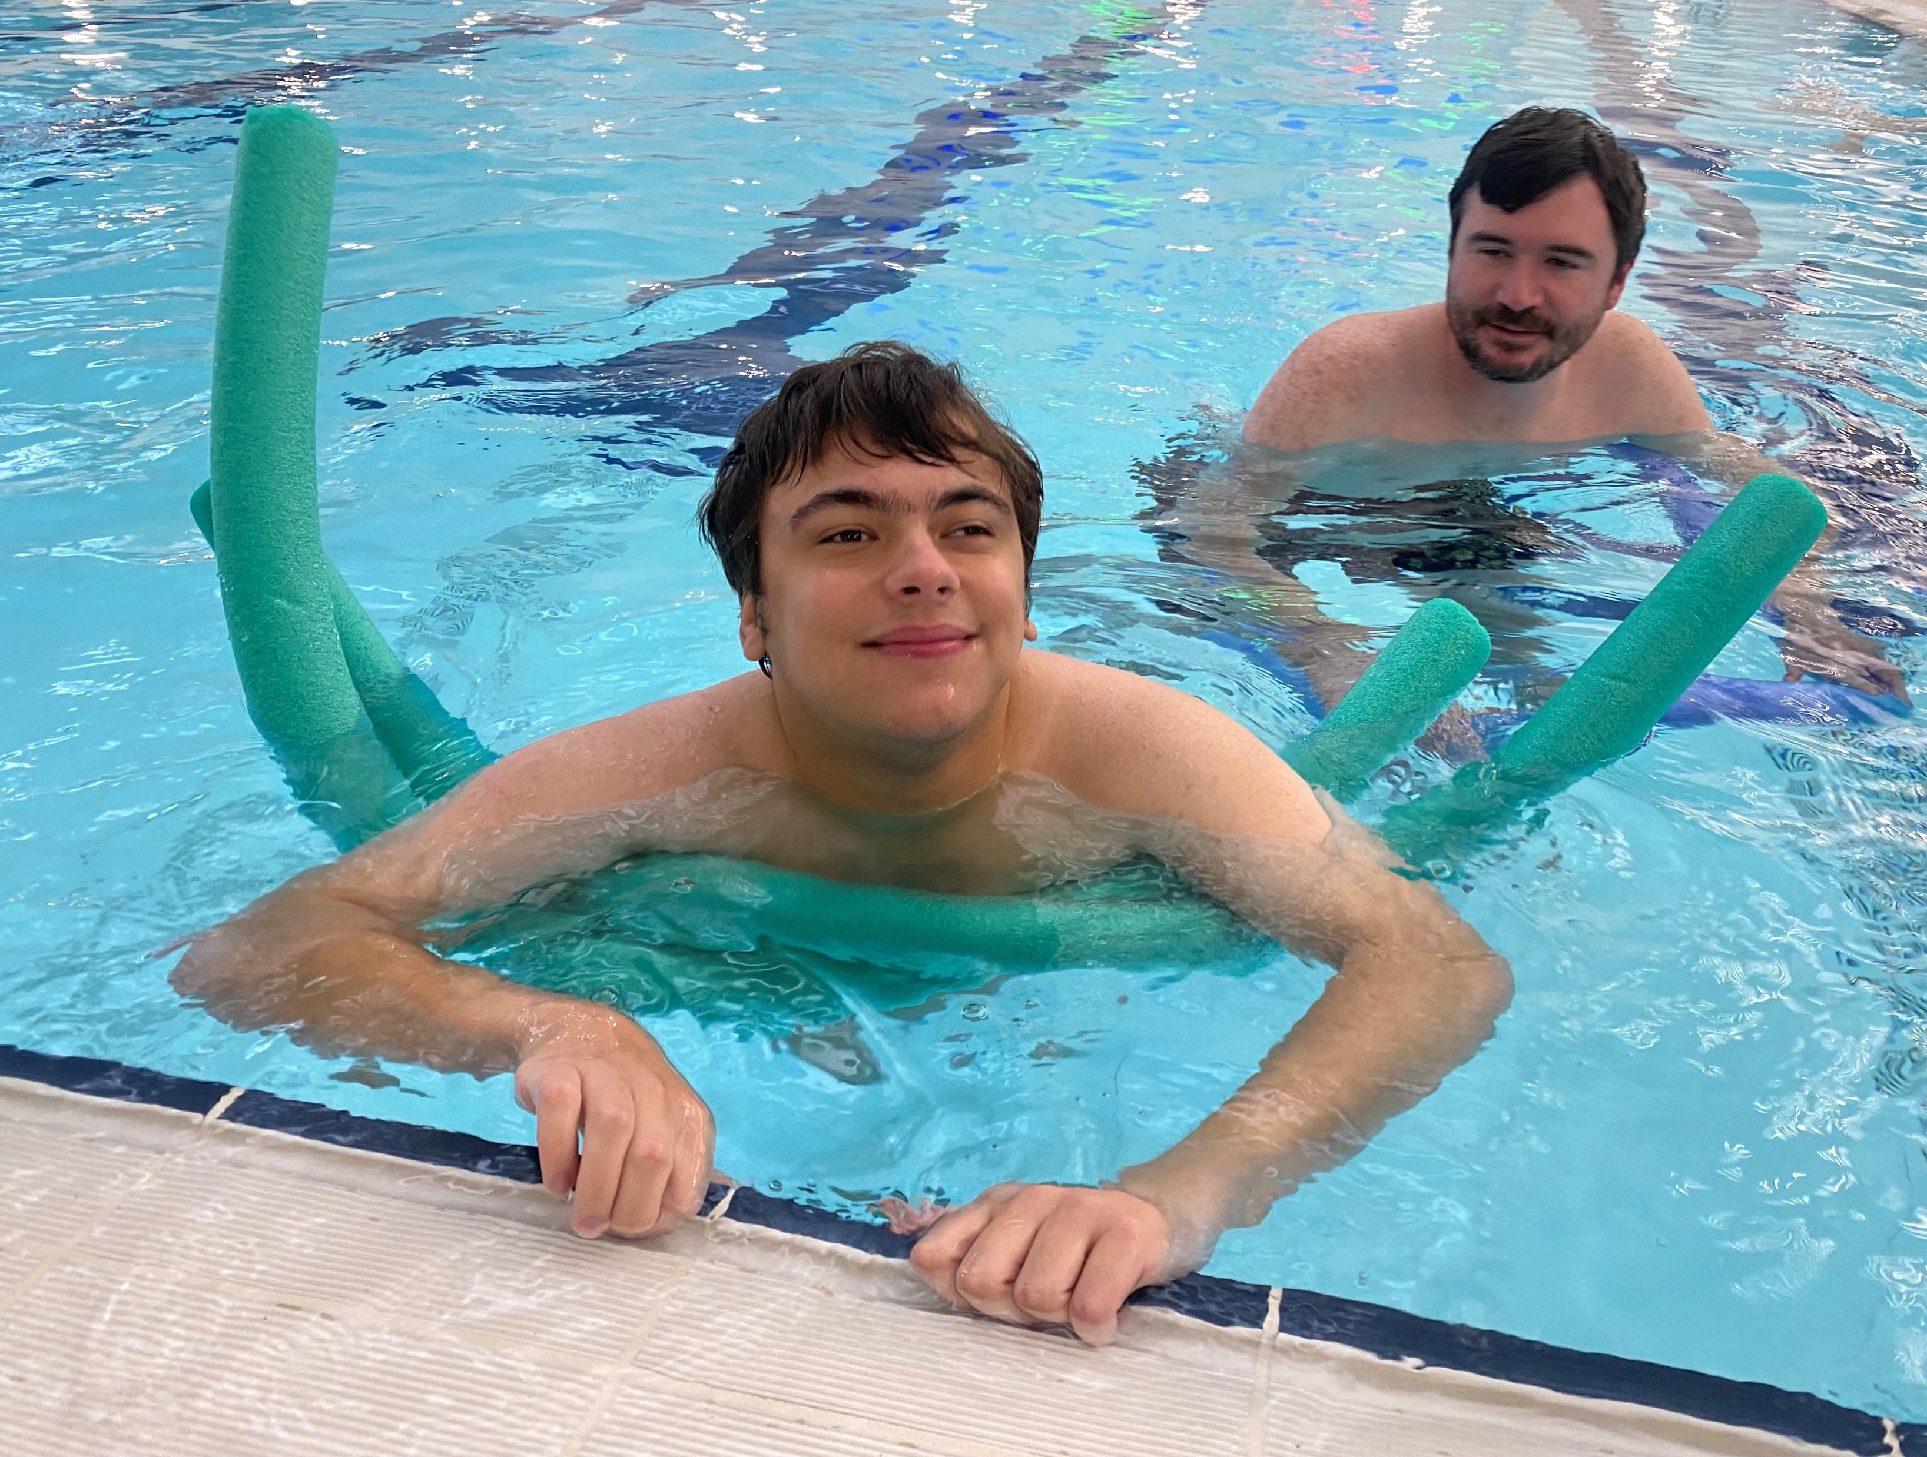
WHY ARE WE FUNDRAISING FOR MENCAP
Watch the Mythbusters in action

Slide 4
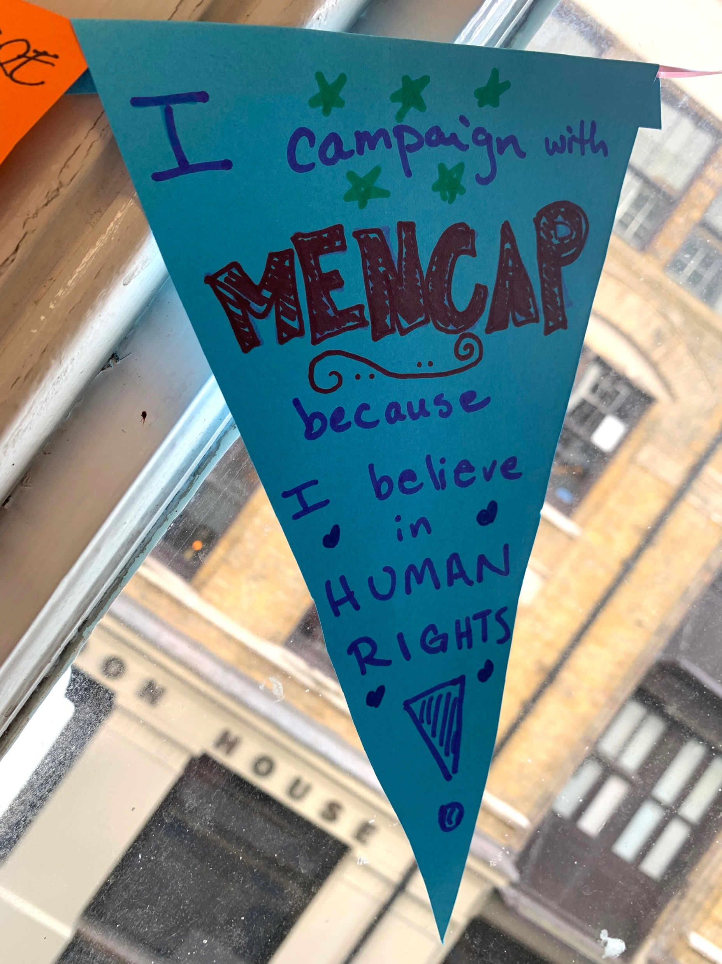
HOW WILL OUR MONEY MAKE A DIFFERENCE?
We will be supporting people with a learning disability across the UK

Slide 5
THE DIFFERENCE YOU CAN MAKE
WITH YOUR SUPPORT WE CAN MAKE UK THE BEST PLACE IN THE WORLD FOR PEOPLE WITH A LEARNING DISABILITY.
£10
£20
£250
£500
could pay for equipment to help people with a learning disability get involved in a new sport.
could help provide vital information and advice to the family of someone with a learning disability. There is such a high demand for our services, with your support we can support people to feel less helpless and alone.
could help us develop virtual services so people with a learning disability can still access vital support in their own home.
could help us provide a training programme for parents of a child with a learning disability so they can give them the best start in life.

Slide 6
THE DIFFERENCE YOU CAN MAKE
WITH YOUR SUPPORT WE CAN MAKE UK THE BEST PLACE IN THE WORLD FOR PEOPLE WITH A LEARNING DISABILITY.
£10
£20
£250
£500
could pay for equipment to help people with a learning disability get involved in a new sport.
could help provide vital information and advice to the family of someone with a learning disability. There is such a high demand for our services, with your support we can support people to feel less helpless and alone.
could help us develop virtual services so people with a learning disability can still access vital support in their own home.
could help us provide a training programme for parents of a child with a learning disability so they can give them the best start in life.
DID YOU KNOW
Almost 1 in 3 young people with a learning disability spending less than 1 hour outside their home on a typical Saturday
Almost 1 in 3 young people with a learning disability spending less than 1 hour outside their home on a typical Saturday
Almost 1 in 3 young people with a learning disability spending less than 1 hour outside their home on a typical Saturday

Slide 7
ADD YOUR OWN TEXT
Add your own text
Add your own text

Slide 8
ADD YOUR OWN TEXT
Add your own text
Add your own text

Slide 9
ADD YOUR OWN TEXT
Add your own text
Add your own text

Slide 10
ADD YOUR OWN TEXT
Add your own text
Add your own text

Slide 11
£
OUR SCHOOL CAN HELP MENCAP CHANGE THE WORLD
£
£
£
How much will we raise?

Slide 12
WE REALLY CAN MAKE A POWERFUL
DIFFERENCE TOGETHER

Slide 13
THANK YOU

