Slide 1



SafeSurfing Module 2
September 2016

Slide 2

Aims of today’s session
Todays training is about the dangers in internet.
The main things we will be looking at are:
  What is public and what is private?
  What is a risky situation?
  How do you feel in a risky situation?
  People who you trust .
  Organisations that can help.
  Dangers from other people online.
  What I have learnt.

Slide 3

What is public and what is private?

Slide 4
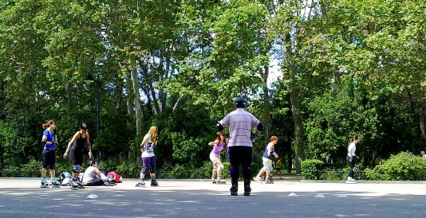

Public and Private
A park is a public location
Your bedroom is
a private location
Notes:
A public location is a place where you can be with other people, that you don’t know or you would not invite.
Example: A park is a public location. There are a lot of people that you don’t know.
A private location is a place where you can be alone or where you can decide who else can be with you.
Example: your bedroom is a private location. You can decide if you want to invite someone or not.

Slide 5
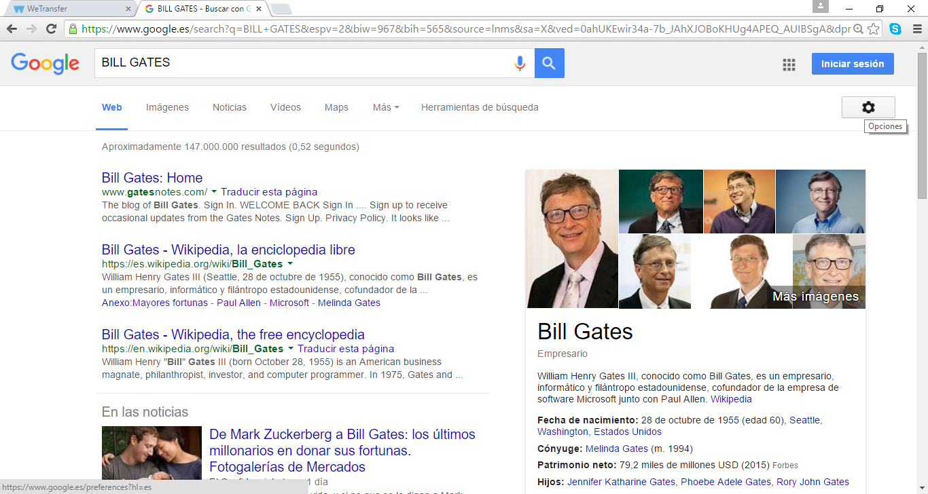
Public and Private
Notes:
On the Internet, there are public and private websites.
That is an example of what appears on Google if we search the name Bill Gates. He is the inventor of Microsoft and one of the richest men in the world.
This information is public. All of us can consult it if we have a computer.
You can make all or part of you Facebook profile private and you can choose with whom you want to share your information.
For example: I do not want my mother to be able to see some pictures with my friends that I upload, so I can set my post on Facebook so she can’t see these.
We can decide what we want to share and with whom we want to do it.
Do I want everyone to know that I’m on holiday? (question for the group) Why? (Danger of being burgled)
Do I want that everyone can see a picture in which I am in? Think about the pros and the cons…
You will received more information about Facebook in module 4.

Slide 6
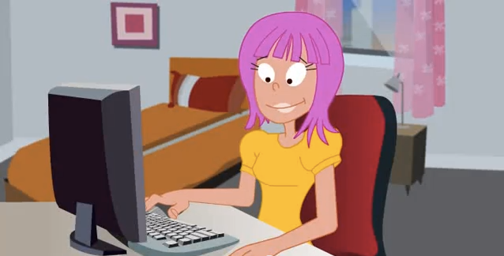
Lets talk about risky situations online
We are not always aware about risky situations we are facing.
It is also important to think about the consequences of our actions.
Lets look at some examples.
Notes:
We are not always aware about risky situations we are facing.
It is important to think about the consequences of our acts.
Sometimes what we do has unexpected or bad results.
Take care with some things on the internet!

Slide 7
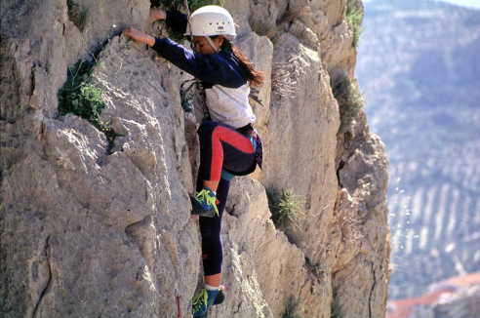
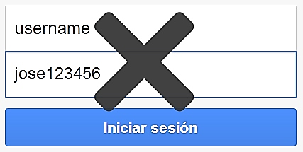
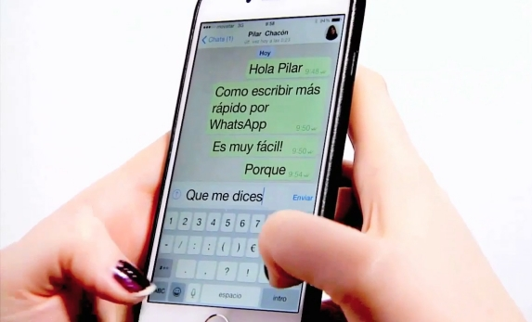
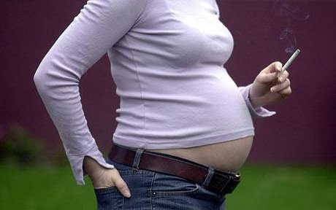
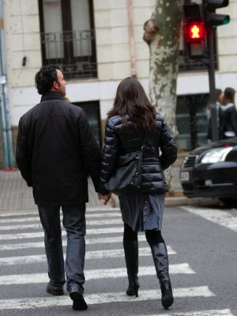
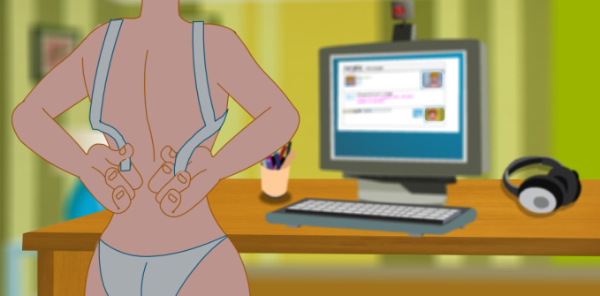
Which of these situations are risky situations?
Climbing
Your password is very common
Texting with friends
Smoking when pregnant
Crossing with red light
Cybersex with your boyfriend or girlfriend
Notes:
To comment with the participants about this different situations (seeing the pictures).
Which are risky situations online? Have a discussion about why they could be risky.
Examples:
Texting with friends is a risky situation?
And what happens if you accept a message of someone that you don’t know?
Having cybersex with your boyfriend or girlfriend is a risky situation?
And what happens if someone that you don’t know in real life asks you to Skype?

Slide 8
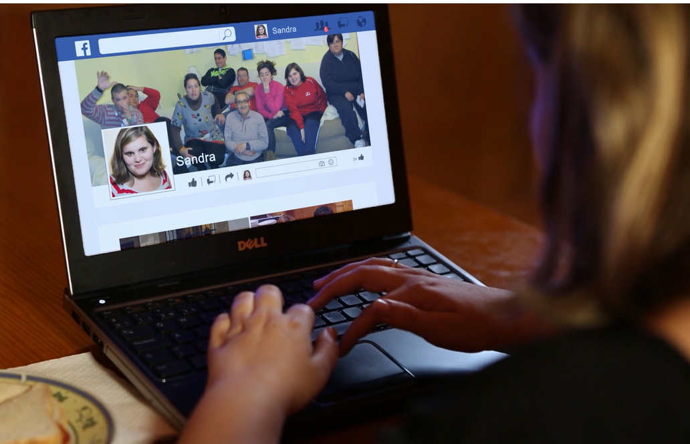
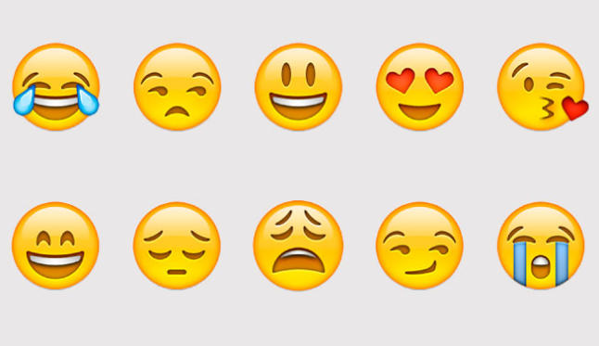
How do I feel in a risky situation?
Your feelings can be signals of alarm
Notes:
It is also really important to take into account your feelings.
If the situation is bad or dangerous for you, your personal feelings will inform you about it.
When you feel angry, or worried, it could mean a risky situation.

Slide 9
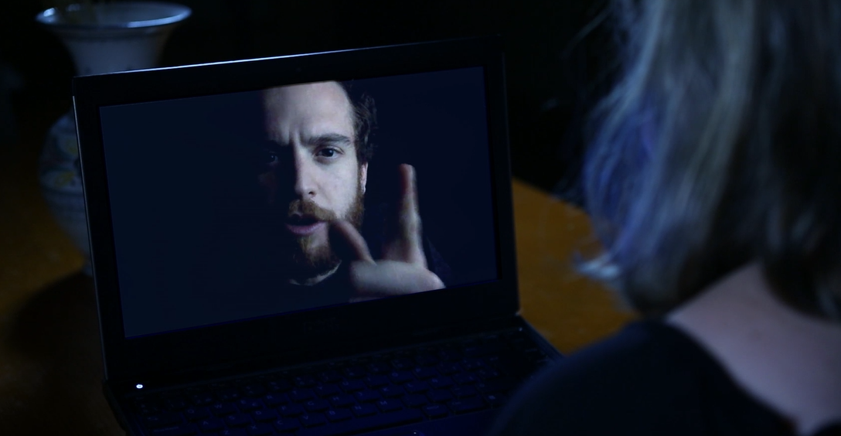






If something similar happened to you, how would you feel?
Notes:
Video for discussion linked to the picture

Slide 10
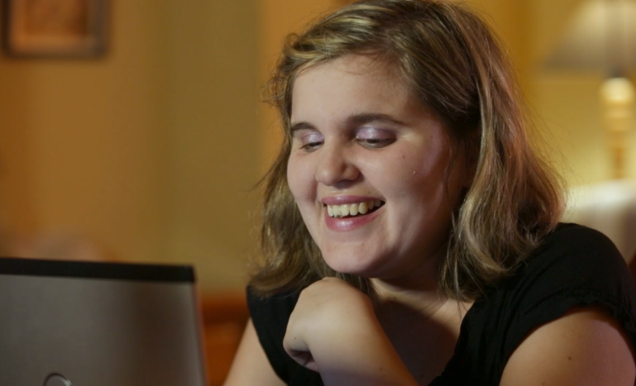
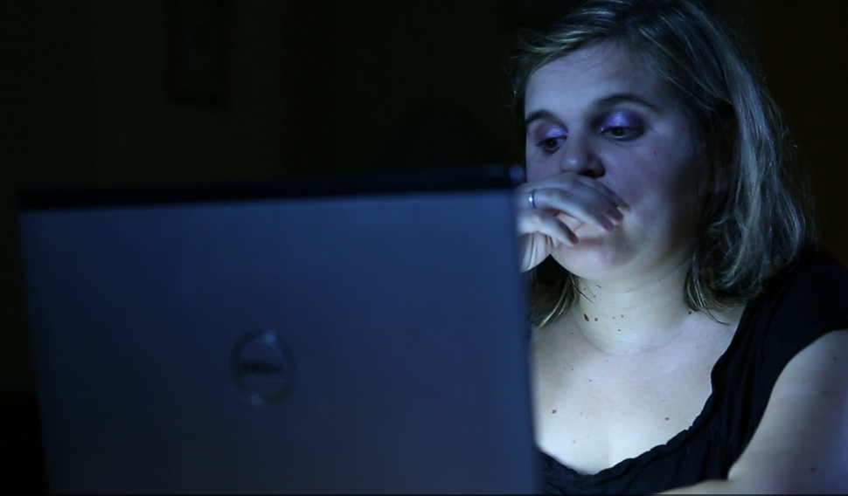
Sometimes, we are not aware about risky situations we are facing.
Because of the lack of information.
Because someone is cheating you.
How does she feel here?
How does she feel here?
What had happened between the first and the second picture?
Notes:
Have a discussion about what changed between these two photos after watching the video.

Slide 11






If something makes us feel wrongthat is a signal of alarm.
If something makes us feel nerv that is a signal of alarm.
If something makes us feel angry that is a signal of alarm.
If something makes us feel sad, that is a signal of alarm.
If something makes us feel insec that is a signal of alarm.
If any of these happen to you,
it is advisable to ask for help from someone on whom you can rely on and trust.
Notes:
Ask the participants if they can show or think about some examples of each feeling
… Wrong
… Nervous
… Angry
… Sad
… Insecure

Slide 12

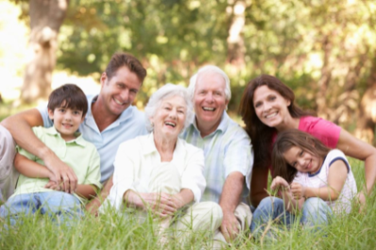



People who you can trust
Notes:
Think about the people you can trust and come up with some examples using the following questions:
Who would you choose to go on a trip with?
From whom would you take advice of opening a bank account?
Who would you choose to tell them a secret?
From whom would you take advice of love issues?
Who would you choose to be with if you feel sad or you would like to cry?
To whom would you ask for help if you find yourself in a risky situation like Sandra’s?

Slide 13


Dangers
From other people
Dangers or bullying from another person or people.
Notes:
There exist different types of dangers.
Danger from other people . This can be dangers such as bullying, in which a person is the victim and another person is the aggressor. Furthermore, it could be possible that the victim or the aggressor could be more than one person.

Slide 14
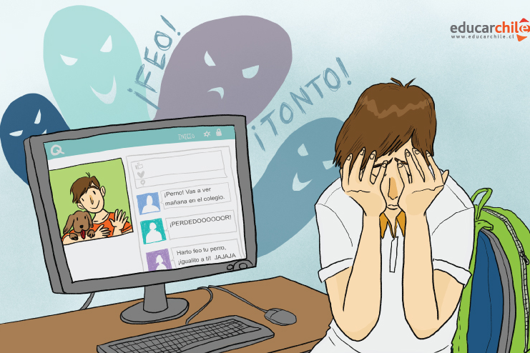
Dangers from other people
Cyberbullying
Notes:
Internet harassment or cyberbullying happens when a person is using the Internet or a mobile phone to bully other people. The bullying can consist of insults, manipulation of pictures, sharing of rumors or even receiving lots of messages.
Cyberbullying
We are going to tell you an actual situation of cyberbullying:
Imagine that you have a group in Whatsapp (or if they don’t use Whatsapp use Facebook).
You like messenging with your friends in this group.
And also you like sharing pictures in this group.
One person in the group keeps telling you nasty things.
You don’t know the reason why and it makes you feel bad.
Questions:
What would you do if that situation happened to you?
How can we avoid this type of situations?
What would you say to the person who sent messages like that?

Slide 15
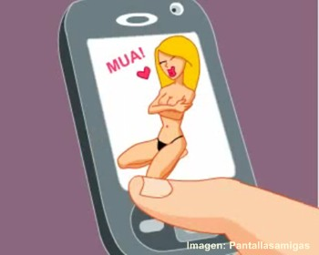
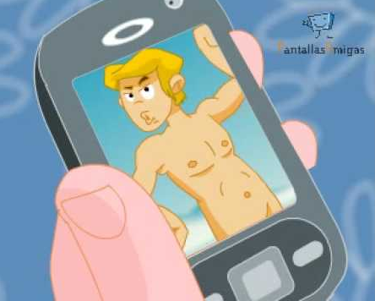
Dangers from other people
Sexting
Notes:
Sexual harassment or “sexting” without permission happens when a person harasses another in order to share erotic or sexual contents without his/her permission.

Slide 16

Consent?
Notes:
What is consent?
It is important to take into account that, if people are of legal age and they give their permission or consent, sexting is not a bad thing.
Remember the risky situations slide.
However, sexting is sometimes used to extort from somebody: the person is forced to do whatever under threatening him/her with uploading pictures of him/herself.

Slide 17

Conclusions of my experience
What have I learnt today?

Slide 18
Finally…
Let’s build some tips together!
………………………………………………………………
……………………………………………………………...
………………………………………………………………
Has anyone got any questions
about any of these tips?

Slide 19

Thank you!
As always, please contact us if you have any questions about the internet!
Notes:
Thank you very much for being part of this training, it has been great.

Slide 20
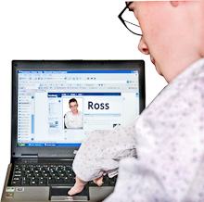
And remember…
have fun online
but always be safe.
Better safe than sorry!

