Slide 1



SafeSurfing Module 4
Facebook and Browser Safety
September 2016

Slide 2

What are we going to learn today?
What is private information
Why You should protect it
Logging off shared computers
Notes:
Today is the first session of the training. We are going to learn how to stay safe on the internet and why is it important to protect your personal data.

Slide 3

Facebook
Now we are going to look at Facebook and show you lots of helpful ways to stay safe and keep your personal data safe.

Slide 4
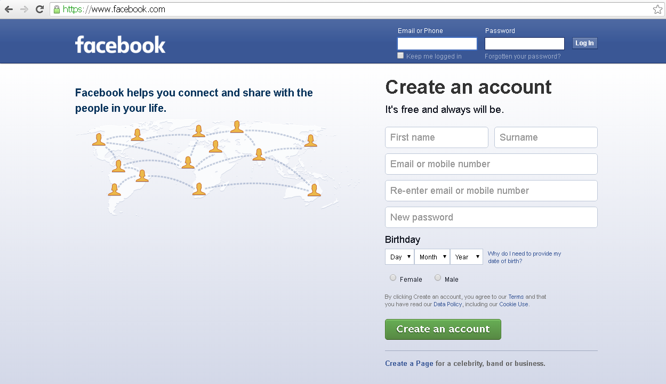
Saving password and staying logged in the browser
Notes:
Saving password in Browser
Trainer:
1.Open facebook;
2 Enter username and password and click log ins
3. Shows the browser's message,
4. Answer Yes to the question in message
5. Ask participants to do the same giving them the same instructions.
6. All shut the browser, open it once again, choose Facebook and check the result.

Slide 5
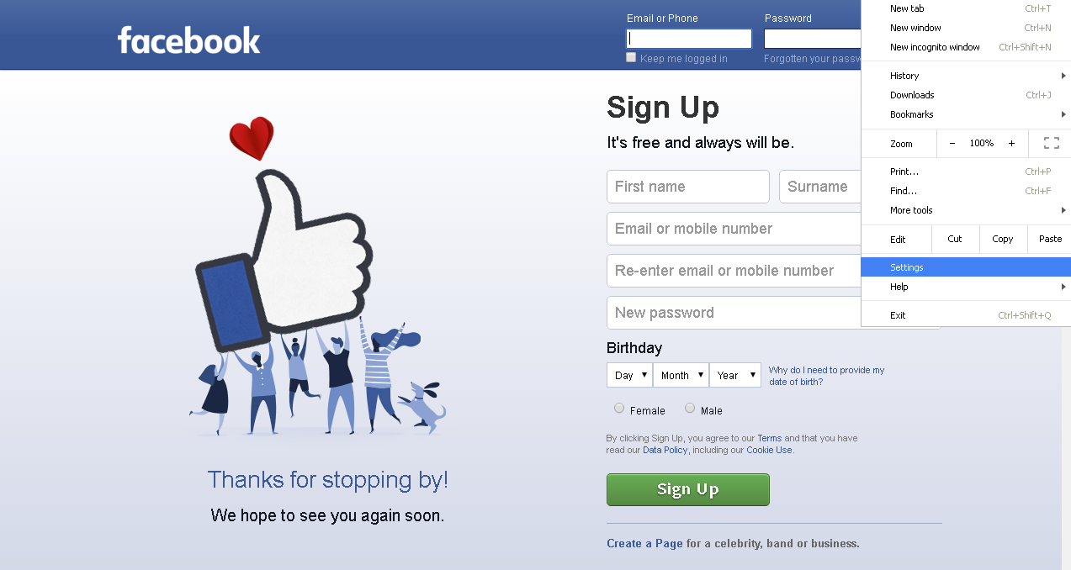
Deleting password in the browser
Notes:
Deleting Password from browser
Trainer:
Explain that this password must be deleted, because otherway anyone can use the Facebook account
Open Settings in the browser
Click show the advanced settings
Shows offer to save Your web passwords.
Click on manage passwords
Delete the passwords that were saved
Click done
Asks participants to do the same
After deleting the passwords participants must check off offering saving passwords.
Trainer shows this checkbox and asks everbody to check it off.
All should shut browser, open it once again and notice there is no offer to save password.

Slide 6
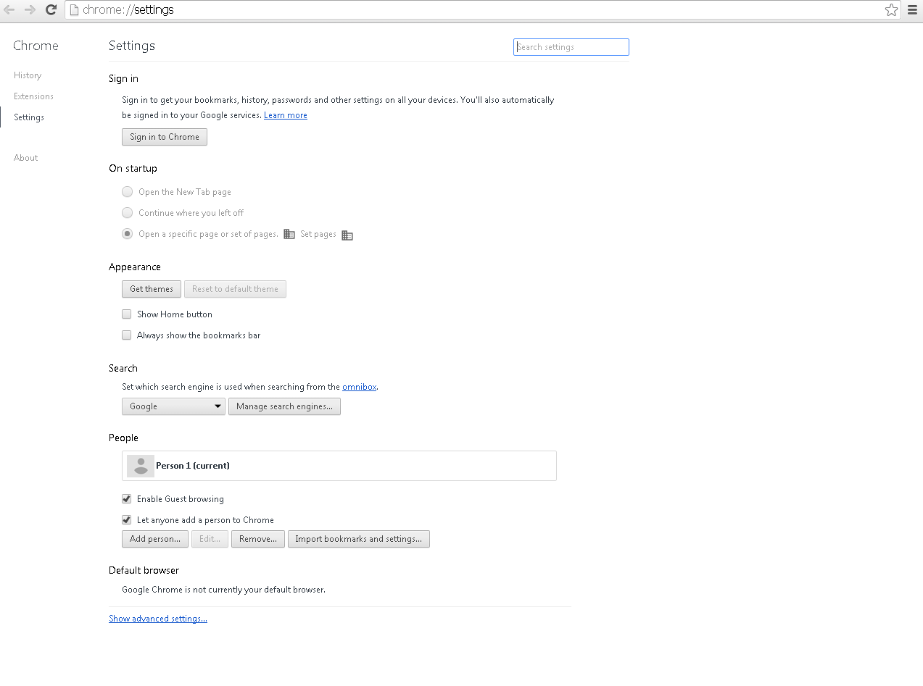
Notes:
Deleting Password from browser
Trainer:
Explain that this password must be deleted, because otherway anyone can use the Facebook account
Open Settings in the browser
Click show the advanced settings
Shows offer to save Your web passwords.
Click on manage passwords
Delete the passwords that were saved
Click done
Asks participants to do the same
After deleting the passwords participants must check off offering saving passwords.
Trainer shows this checkbox and asks everbody to check it off.
All should shut browser, open it once again and notice there is no offer to save password.

Slide 7
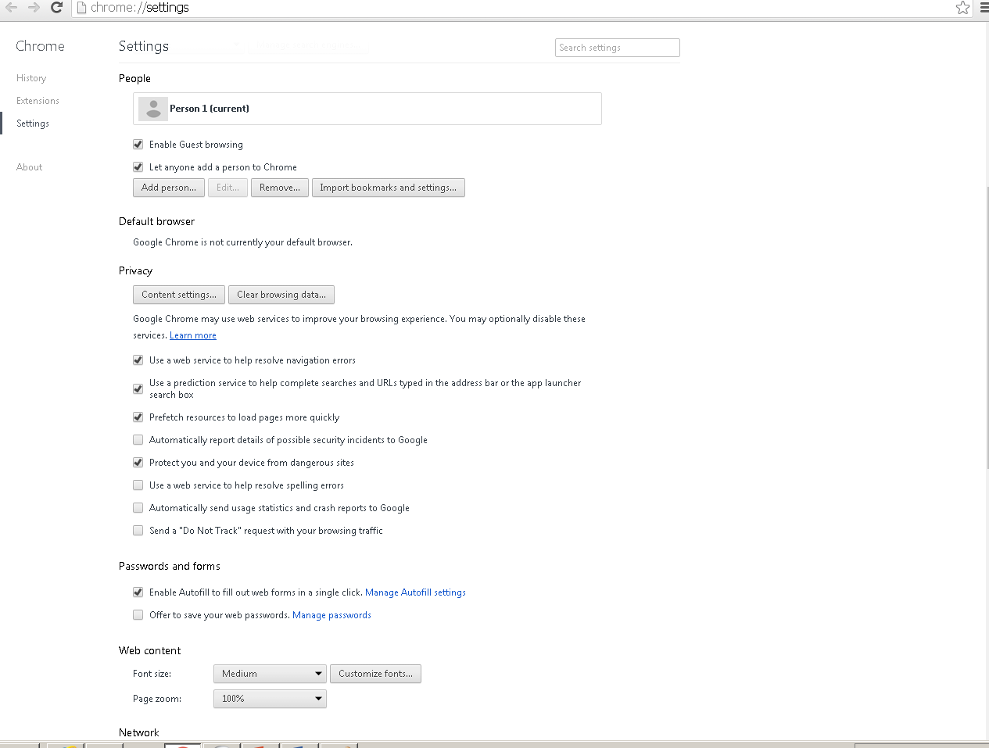
Notes:
Deleting Password from browser
Trainer:
Explain that this password must be deleted, because otherway anyone can use the Facebook account
Open Settings in the browser
Click show the advanced settings
Shows offer to save Your web passwords.
Click on manage passwords
Delete the passwords that were saved
Click done
Asks participants to do the same
After deleting the passwords participants must check off offering saving passwords.
Trainer shows this checkbox and asks everbody to check it off.
All should shut browser, open it once again and notice there is no offer to save password.

Slide 8
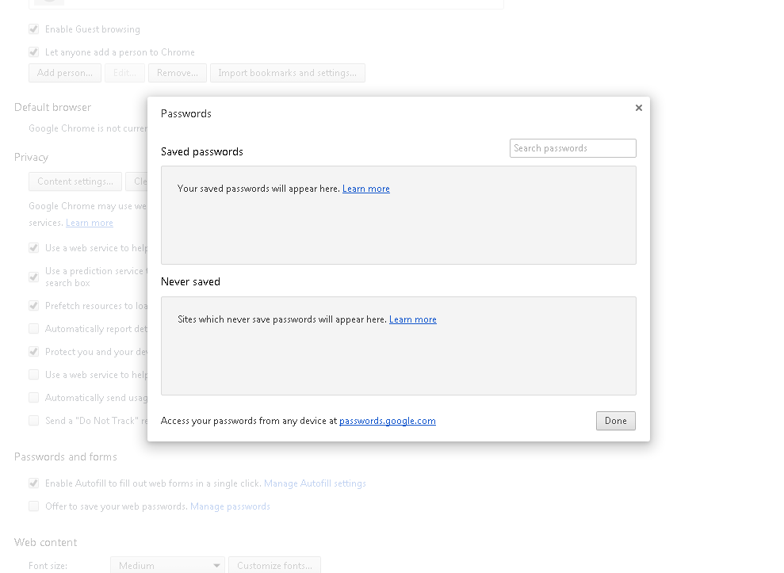
Notes:
Deleting Password from browser
Trainer:
Explain that this password must be deleted, because otherway anyone can use the Facebook account
Open Settings in the browser
Click show the advanced settings
Shows offer to save Your web passwords.
Click on manage passwords
Delete the passwords that were saved
Click done
Asks participants to do the same
After deleting the passwords participants must check off offering saving passwords.
Trainer shows this checkbox and asks everbody to check it off.
All should shut browser, open it once again and notice there is no offer to save password.

Slide 9
Notes:
Deleting Password from browser
Trainer:
Explain that this password must be deleted, because otherway anyone can use the Facebook account
Open Settings in the browser
Click show the advanced settings
Shows offer to save Your web passwords.
Click on manage passwords
Delete the passwords that were saved
Click done
Asks participants to do the same
After deleting the passwords participants must check off offering saving passwords.
Trainer shows this checkbox and asks everbody to check it off.
All should shut browser, open it once again and notice there is no offer to save password.

Slide 10
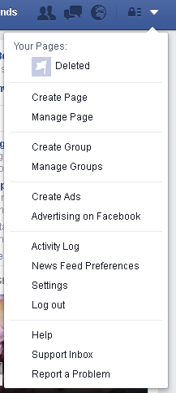
Setting profile as public
Notes:
Setting profile as Public
Trainer:
Ask participant’s to login to facebook
Opens your facebook settings, asks all to do the same
Click on Privacy
Click on Who can view my future posts, set as PUBLIC
Click Close
Explains that now we have a public profile and all what we post will be seen to everyone who is on facebook.

Slide 11
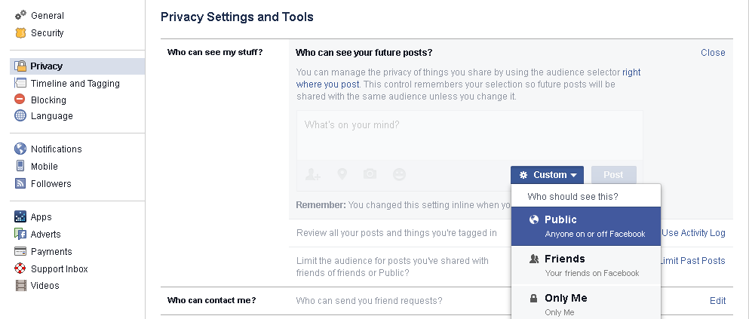
Notes:
Setting profile as Public
Trainer:
Ask participant’s to login to facebook
Opens your facebook settings, asks all to do the same
Click on Privacy
Click on Who can view my future posts, set as PUBLIC
Click Close
Explains that now we have a public profile and all what we post will be seen to everyone who is on facebook.

Slide 12
Setting profile as private
Notes:
Setting profile as private
Teacher:
Go to settings
Go to Privacy and set profile visible only for friends.
Explain that now only people who are your friends on Facebook can see your posts and profile.

Slide 13
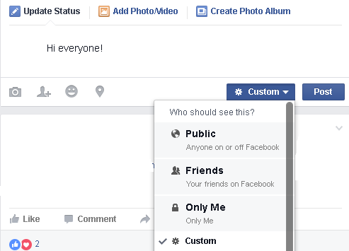
Public and private posts
Notes:
Write a short post on your status update
Click on the blue box next to post and show that on the drop down menu there are several options for choosing who can see your post.
Show there is one for public and one for friends.
Explain that if it is public anyone can see it, and that if it is just friends only your friends will be able to see it.

Slide 14
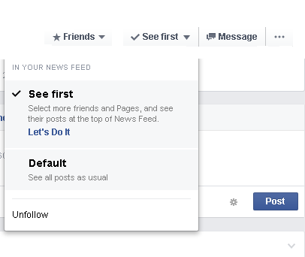
Following
Notes:
Following
Teacher
Explains why sometimes it is good to set do not follow on a friend, for example your friend might post things you are not interested in too often for your liking, therefore if you unfollow them you will only see their posts if you go to their profile.
Go to a profile of a friend
Click on the white box next to message saying follow.
Choose unfollow

Slide 15
How to block someone
Notes:
How to block someone
Explains what is blocking
Opens Settings and click Blocking
Ask to write in a name and choose Block
(Remind them to unblock if it is someone they didn’t want to block forever)

Slide 16
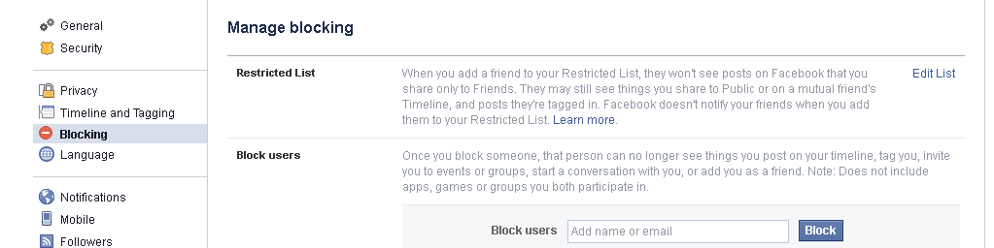
Notes:
How to block someone
Explains what is blocking
Opens Settings and click Blocking
Ask to write in a name and choose Block
(Remind them to unblock if it is someone they didn’t want to block forever)

Slide 17
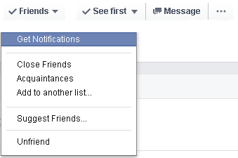
How to unfriend someone
Notes:
How to unfriend someone
Explains unfriending someone is
Go to the person’s profile you want to unfriend
Click on the friends button near their profile picture
Click on unfriend
Say yes to the message that comes up

Slide 18
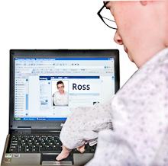
In summary
Notes:
A video to summarise what we have gone over linked to the picture.

Slide 19

Thank you
Thank you
We look forward to seeing you for the next session

