Slide 1
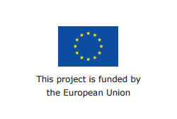
SafeSurfing Module 1
How to use the internet safely and How to protect my personal data?
September 2016

Slide 2
Who we are
Insert Trainer Photo Here
Insert Trainer Photo Here
Insert Trainer Name Here
Insert
Trainer
Name Here
Notes:
Trainer : I’m ……………. and this is …….. we will be your trainers for the 5 sessions of this course.

Slide 3
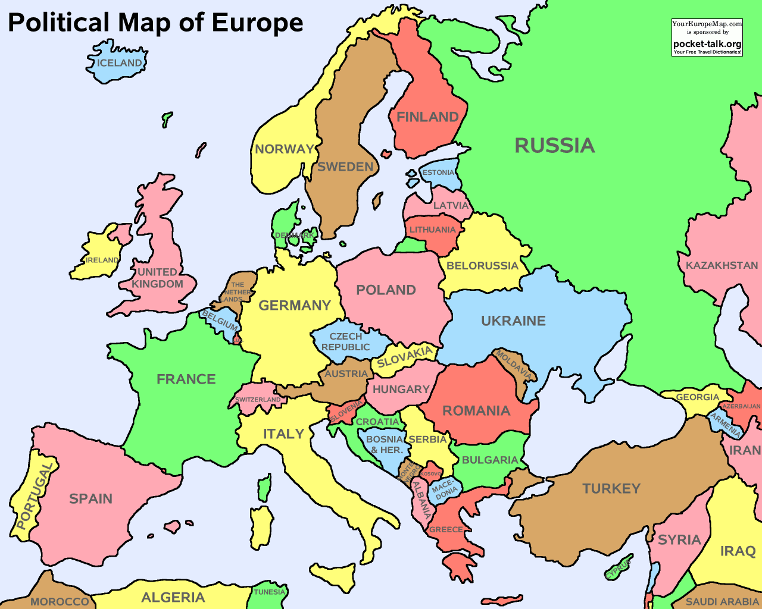
The Safe Surfing project
Notes:
This training has been put together by five countries in Europe: Italy, France, Spain, Poland and the United Kingdom.
The training has been made to make sure that everyone understands the importance of keeping yourself safe online, and how to do this.

Slide 4
What is the SafeSurfing project?
Notes:
Inclusion Europe has put together a short video explaining what the SafeSurfing Project is, that we are now going to watch.

Slide 5
What are we going to learn today?
How to stay safe on the internet
What is personal data
How to protect your personal data
Where to ask for help if things go wrong
Notes:
Today is the first session of the training.
We are going to learn how to stay safe on the internet and why is it important to protect your personal data

Slide 6
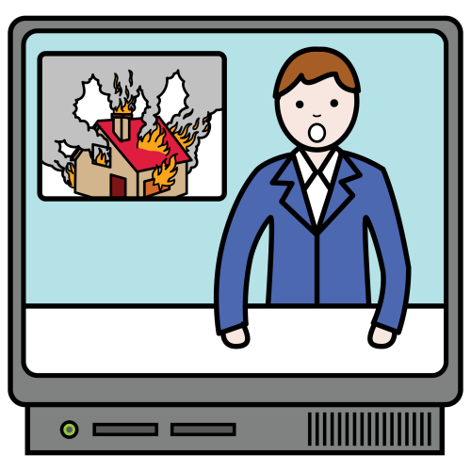
We use the internet for many things
Notes:
We use the internet for many things:
Search for information
Read the news
Shopping
Chat with friends
Spend time on social media like Facebook, Twitter, Instagram

Slide 7
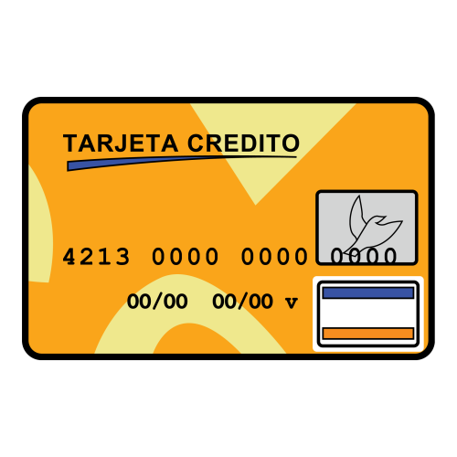
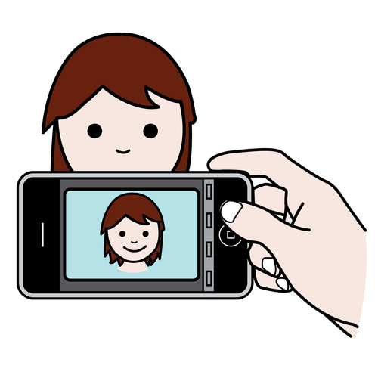
When you use the internet, you post A LOT of information about you online
Notes:
When you use the internet, you post A LOT of personal information online.
People know things about you through your Facebook profile or your Twitter account :
They can find out:
What you look like (Profile Picture)
Your name
Your email
Your phone number
And Where you work

Slide 8
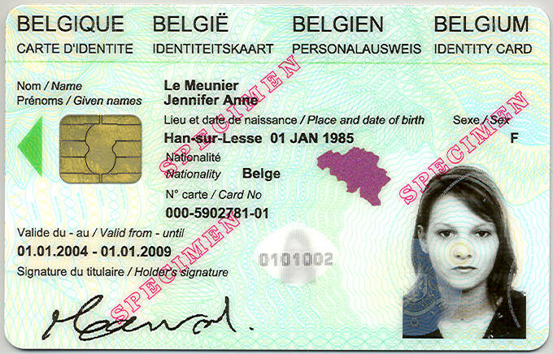
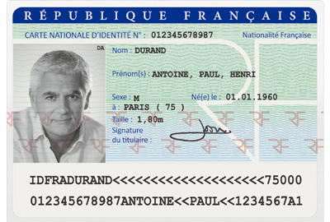
Would you share this information with people you don’t know ?
NO!
Notes:
Would you share these information with people you don’t know ?
No, because with this information someone can identify you.
They are personal information about you and your life. We call it personal data.

Slide 9
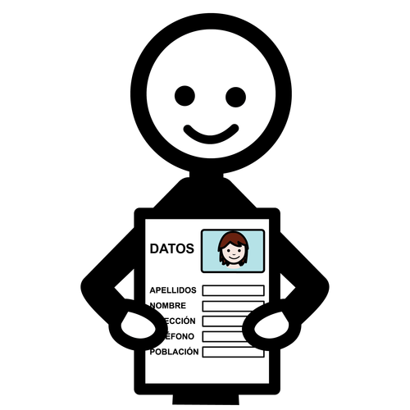
Let’s try! Is it personal data?
My name ?
My Address?
My age?
Where I work?
My bank account number?
My email?
Notes:
Exercise :
Is this personal data?
My name?
My address?
My age?
Where I work?
My bank account number?
My email?
Why shouldn’t I share this personal data? What could happen ?

Slide 10
What happens to my personal information?
The internet can be dangerous
Everything you share on the internet stays there forever
Notes:
Internet can be dangerous.
Everything you share on the internet stays there forever.
A lot of people you meet online might not be nice.
Sometimes you cannot trust them.
They might try to steal your personal information
and pretend they are you, or they might bully
or hurt you!

Slide 11
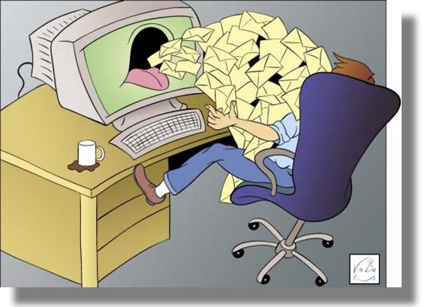
Spam
The information you
share could be used by companies to send you emails you don’t want, or show you adverts!
Notes:
If you give your personal data to a company, they should say what they will do with it and why they need it.
They can only share your personal data if you said that you agree.

Slide 12
How can I control my information?
You wouldn’t give your house keys to someone you don’t know, so don’t share your passwords either!
Notes:
Do not do anything online that you wouldn’t do in real life! You wouldn’t give your house keys to someone you don’t know, so don’t share your passwords either.
Make sure your passwords are hard to guess. Use letters, numbers and symbols to make them hard to guess. Do not use the same password for all your accounts!

Slide 13
Don’t forget to log off!
Always remember to log off any public computer you use, like the ones in libraries or community centers.
Notes:
Always remember to log off any public computer, like the ones in libraries or community centers.

Slide 14
Do not install applications that ask to use your personal information, or post on social media for you.
Notes:
Do not install applications that ask to use your personal information, or post on social media for you.

Slide 15
Look out for the S
Notes:
Look out for the S: on website addresses.
Never enter your personal details into a website unless the URL starts with HTTPS.
S stands for Secure. It means that you can safely use your debit or credit card on that website. If there is a lock in the address bar it means that it is safe.

Slide 16
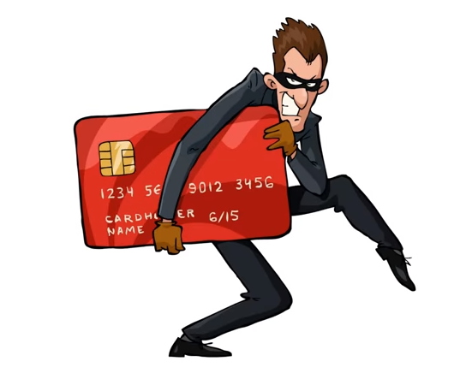
Don’t give out your personal information
Notes:
Be careful, sometimes it happens that a person or a company plays the role of another person or company that you know. For instance, they might send you an email or a text asking you for personal information. You need to know that your bank will never ask you about your personal details (including your pin code) by email or text.

Slide 17
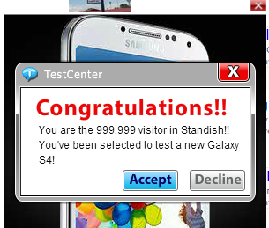
Use Anti-Virus Software
malware
Notes:
Viruses are computer programs that are installed on your computer without you knowing it. It can happen if you click on pop-up windows that happen to be a trick. They can delete files or damage your computer.
This is why it is important to have an anti-virus installed on your computer.

Slide 18
Conditions of use
Notes:
When we create a profile on a social network, most of us do not read the terms and conditions of use. Most of the time, these conditions say that if we use the social network we are sharing our data with the enterprise that owns the app or, even sometimes, we are losing our rights on the pictures we upload.
Every picture you upload on Facebook, belongs to Facebook. The same thing happens with the Youtube videos you upload. The information we use in Google or in our mail, it is used to offer us advertisements. Therefore, you need to be extra careful of what you post on social media because they have the right to keep those information.

Slide 19
What are my rights?
You have the right to know what happens to your data
You can ask for information that you can understand
Notes:
If your personal information has been used in a way that you think is not ok, ask for help!
As a European citizen, you have the right to know what happens to your data.
You can ask for information that you can understand!
You can ask organisations to tell you what type of information they have about you.
You can ask websites to delete information about you. And, if your information is used in a wrong way, you can even get compensation!

Slide 20
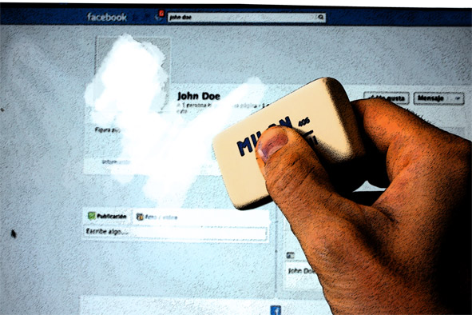
Right to be forgotten
Notes:
You have the right to be forgotten by companies. This means that when you can’t delete your profile on their website or their app, they should delete your data and not keep your data without permission.

Slide 21
What have we learned today?
What is a personal data
What happens to my personal data
Why I should be careful when sharing my personal data
How I can control my information
What are my rights
Where to ask for help

