Slide 1
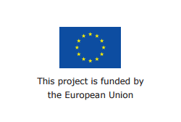


SafeSurfing Module 5
September 2016

Slide 2
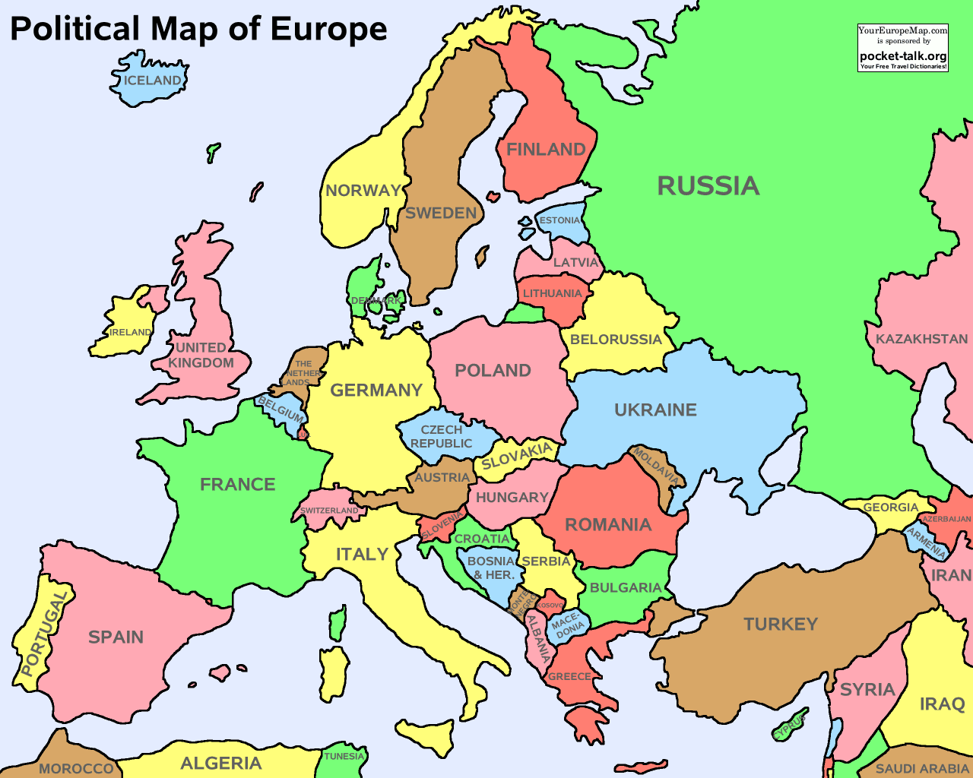
The SafeSurfing Project
Notes:
Hi everyone, This is the fifth and final training session of the Safe Surfing training. This training has been put together by five countries in Europe: Italy, France, Spain, Poland and the United Kingdom.
The training has been made to make sure that everyone understands the importance of keeping yourself safe online, and how to do this.

Slide 3
Who we are
Insert Photos and Trainers’ Names
Notes:
I’m …….. and this is ………., hopefully you will recognize us by now!

Slide 4

Recap from the last session
What did you learn?
Notes:
To prompt if required
How to login to facebook
How to block someone
How to set your profile safely

Slide 5

Aims of today’s session
To remind ourselves this is what we have learnt in the training so far, including:
Why the internet can be great
Why we need to be careful on the internet
Who to share information with
What information to share
How to get help
Final tips about how to be safe
Notes:
Todays training is about looking at all that we have learnt in the last few training sessions, and summing up what we need to remember about the internet.
The main things we will be looking at are: Why the internet can be great, why we need to be careful on the internet, who to share information with, what information to share, how to get help and finally some main tips about how to be safe.

Slide 6
Why the internet can be great
Fill in petitions
Play Games
Watch funny videos
Online dating
Stay in touch with family
Email complaints when I’m not happy
Make new friends
Notes:
The internet is great – there is so much you can do, we have put a list of a few of the things that make the internet great.
These include: meeting and making new friends, buying things, watching funny videos, but don’t forget to use your time online to do more like finding out facts campaigning to your local or countries government, reading the news.

Slide 7
Why the internet can be great
Exercise: Three stars and a wish
Notes:
The first exercise now – we asked you before today to fill in the ‘Three stars and a wish’ sheet. In the three stars we wanted you to list the three things you like best about the internet. We would like to hear what you put to add to the list that we put together.
If you didn’t get a chance to fill the sheet in, it doesn’t matter, can you tell us what you would have written?
I would have written in one of my stars that ‘I can be invited to parties and to meet up with my friends on Facebook’
What about you?

Slide 8
But, we do need to be careful on the internet
Exercise: Three stars and a wish
What is your wish?
Notes:
But as we’ve learnt in other sessions, the internet can have problems, and bad things can happen online.
If you could let me know what one thing that you would like to change or something that you think could be improved about the internet?
Mine would be ‘I wish that people wouldn’t say nasty things online that they wouldn't say to my face’
What have you put?
So I think we understand that although there is lots of good things about the internet, it’s not perfect and we need to be careful what we do on there.

Slide 9

Who do you share your information with?
We need to think about:
Who we share our information with
When we share it with them
Where we share it with them
Notes:
Firstly we need to think about who we share information with.
People who we are friends with online can often still be strangers, even if we think we know them quite well.
We really need to make sure that we know who are our real friends and who isn’t, so that we can make sure that we are safe.

Slide 10
Who do you share your information with?
Exercise: Online and Offline Friends
People I know online
People I know online & offline
People I know offline
Notes:
Now it is time to look at the second worksheet that you have done. We asked you to look at the sheet called ‘online and offline friends’. Did everyone have a look at this? Did everyone understand how it works.
This diagram shows how some people are your friends in the real world, some are your friends that you know only online, and some you know online and offline. (Make sure they understand what Offline means, and explain if not).
Would someone like to start and tell us some of the people you would put in each of these circles? Only share this information if you feel comfortable doing so.

Slide 11
What information should you share online?
There are lots of different types of information about yourself
Some is private information – no one should know it apart from you and your close family or carer
Some information can be shared with some people that you know well
And some information is ok to share with anyone that you want to share it with
Notes:
Hopefully you now know what information is collected about you online, and what information you need to keep to yourself.

Slide 12


What information should you share online?
Exercise: Keep it safe or share it?
Notes:
We are going to show you some different types of information about you, and we want to know whether you should keep this information safe or share it.
If you can shout out safe or share depending on what you think and we will see if we all agree. Ready?

Slide 13
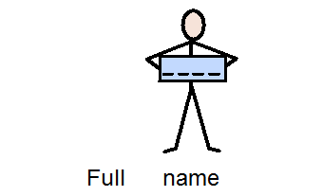
‘
Safe or share?
Notes:
Your full name? Safe or Share?

Slide 14
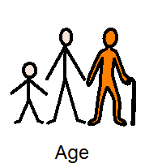
Safe or share?
Notes:
Your age? Safe or Share? When might you need to give your age?

Slide 15

Safe or share?
Notes:
What about your password? Safe or Share? Is there ever a time when you’d give your password to someone online?

Slide 16
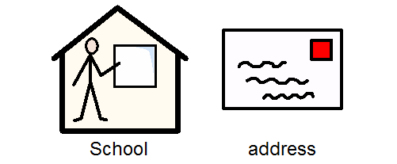
Safe or share?
Notes:
What about your school address? This is a bit trickier. Safe or Share?
Why would you not want to put this up on somewhere like Facebook?

Slide 17
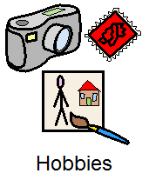
Safe or share?
Notes:
Your hobbies. Safe or Share ?

Slide 18

Safe or share?
Notes:
Your favourite colour? Safe or Share?

Slide 19
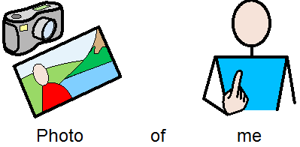
Safe or share?
Notes:
What about photos of you? Safe or Share?
How do you decide if the photo is ok to go up? Who should choose if it goes up or not?

Slide 20
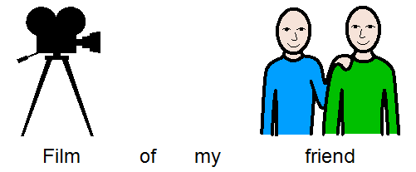
Safe or share?
Notes:
And what about a video of your friend? Safe or Share?
Why would you not just put it up without asking them?

Slide 21
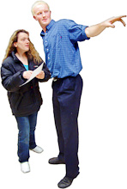

How to get help?
Do you?
Ignore it
Sort it out yourself
Ask someone for help
Notes:
So what do you need to do if someone does have information about you that shouldn’t, or something online makes you upset? Ignore it ?Sort it out yourself, or ask someone for help?
What’s the right answer?

Slide 22
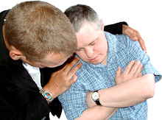
How to get help?
Correct!
But, who would you ask for help?
Notes:
Correct! Always ask someone for help, however silly it seems, or if you’re not sure that something can be done about it, always ask someone for help.
But who do you ask?

Slide 23
How to get help?
Parent/guardian
Sibling
Other family member (Uncle/Auntie/Cousin/Grandparents etc.)
Friends
School staff member
Other trusted adult outside of school ( like an adult who runs a club you attend)
Police
Helpline
Website
Using reporting buttons/tools on a site/service
Notes:
This is the list that we came up with, who would you go to first? Can anyone think of anyone else you may ask?

Slide 24
How to get help?
We need to remember that if anything on the internet worries or upsets us, we must:
Always tell someone
Always report it
Always block someone
Always save the evidence
In the UK, the organisation that helps us with this is called the
Information Commissioners Office.
They can be found at the website: ico.org.uk/
Notes:
We need to remember that if anything on the internet worries or upsets us, we must always tell someone, always report it, always block someone and always save the evidence.
Do people know what save the evidence means? It means that you need to keep the message or thing that is upsetting you so that you can show it to someone else.
In the UK, we have an organisation called the Information Commissioners Office. They have a website which tells us all about our rights about our data, about the laws that companies have to follow, and what we need to do if they are not following these laws and keeping information that it is not right for them to keep.
They are also the organisation that we can make a complaint to, about things that happen to us online.

Slide 25

Finally, some key tips!
Key tips:
Notes:
Lets watch a video with some top tips on being safe online! (Video linked to the photo)

Slide 26
The tips
Look out for the S: on website addresses
Don’t put your personal details on the internet
Don’t add people you don’t know on social media and keep your profile secure
Beware of Trolls
Beware of the link in emails from people you don’t know
Has anyone got any questions about any of these tips?
Notes:
Trainer: These are the five tips here, has anyone got any questions about any of these tips?

Slide 27

Thank you for attending our training!
And remember…
Have fun online
But always be safe!
Notes:
Trainer: And remember, always be safe online.

